Slide 1
Electrostatics
Wenny Maulina

Slide 2
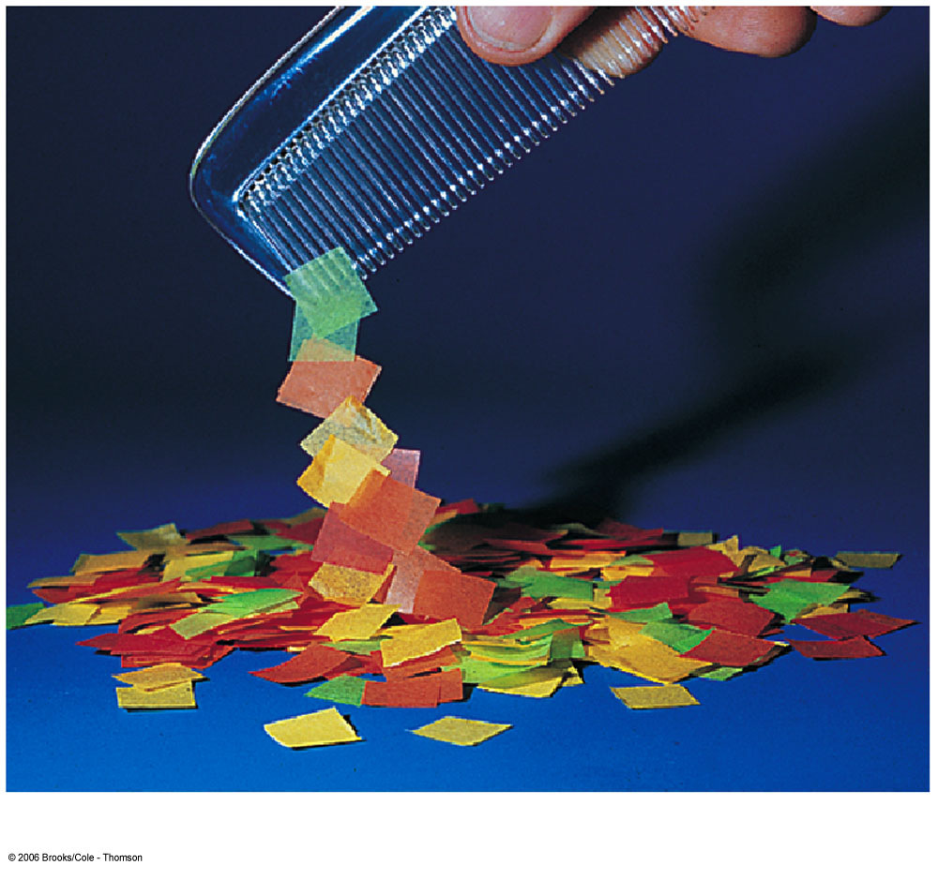

Slide 3
Electric charge
Protons have positive charge
Electrons have negative charge
Opposite signs attract
Similar signs repel
Electric field – used to calculate force between charges

Slide 4
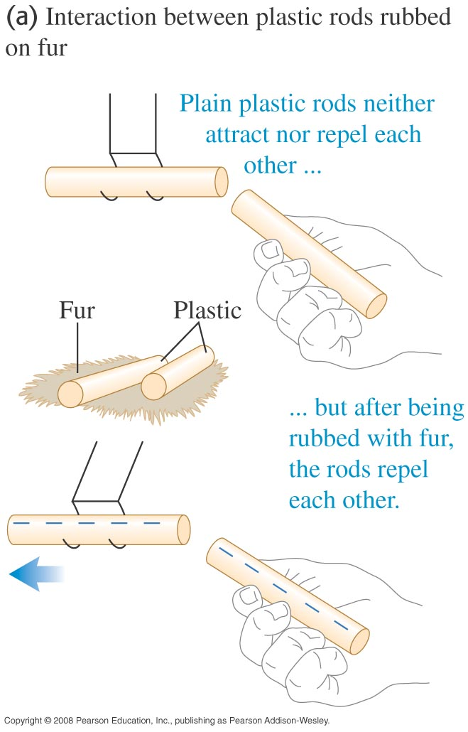

Slide 5
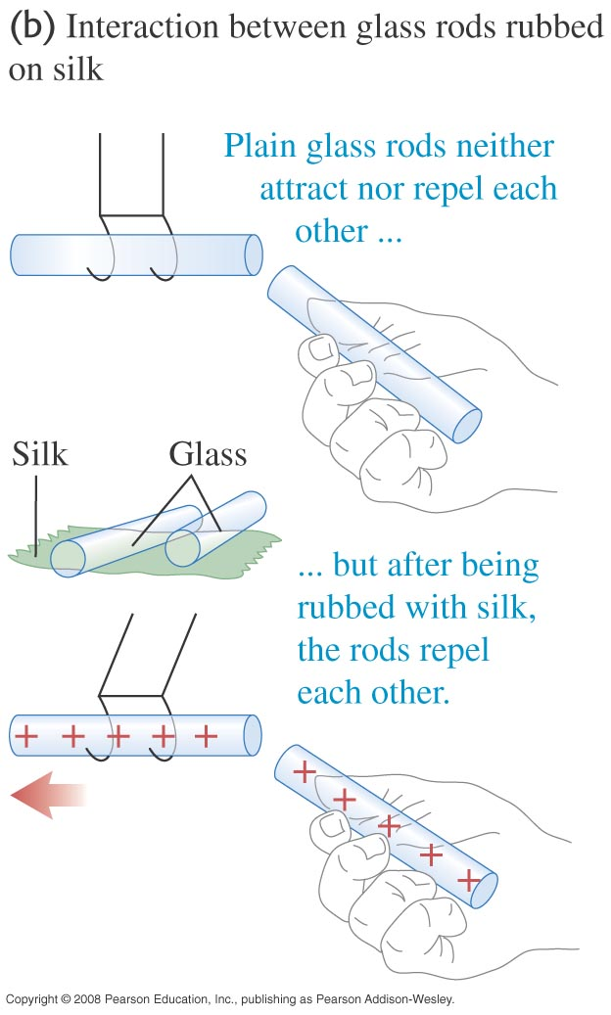

Slide 6
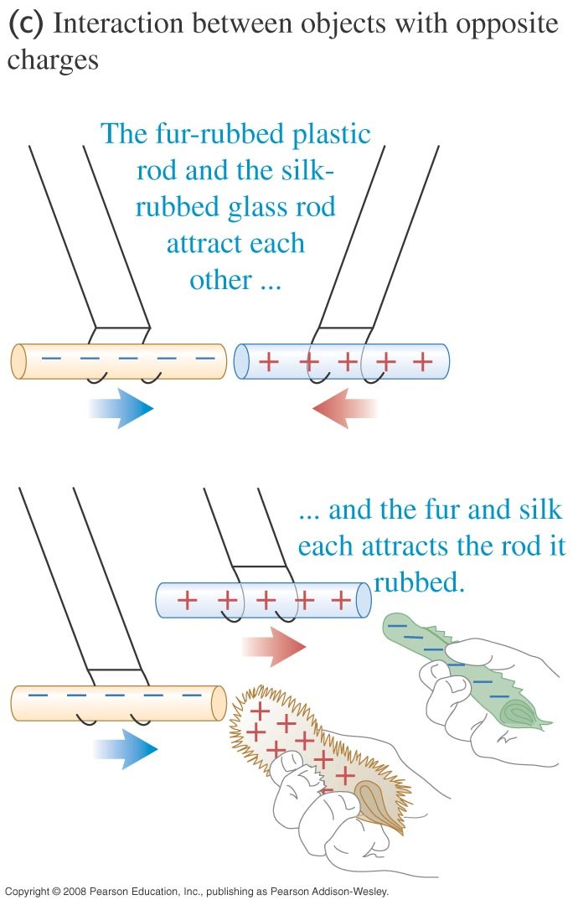

Slide 7
Where do charges come from?
Matter is made up of atoms.
+
Proton (positive charge)
–
neutron (neutral)
+
+
+
–
electron (negative charge)
–
–
atom
nucleus

Slide 8
Where do charges come from?
If electrons = protons ⇒neutral
If electrons > protons ⇒ gaining electrons, negative charge
If electrons < protons ⇒ losing electrons, positive charge

Slide 9
Electric Charge
The unit of electric charge is the coulomb (C).
The smallest amount of charge that can be added or removed from an object is the elementary charge, e = 1.6 × 10⁻¹⁹ C.
The charge of a proton is +e, an electron -e.
The charge of an object, Q, is always a multiple of this elementary charge: Q = N e, where N is an integer.

Slide 10
Example
Hitunglah muatan total dari 40 kg proton?

Slide 11
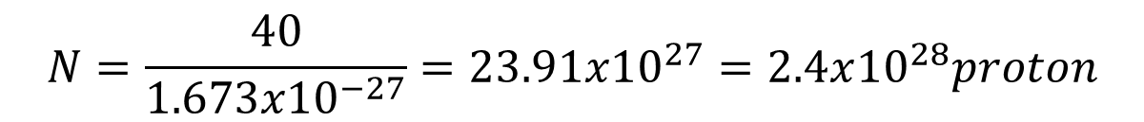
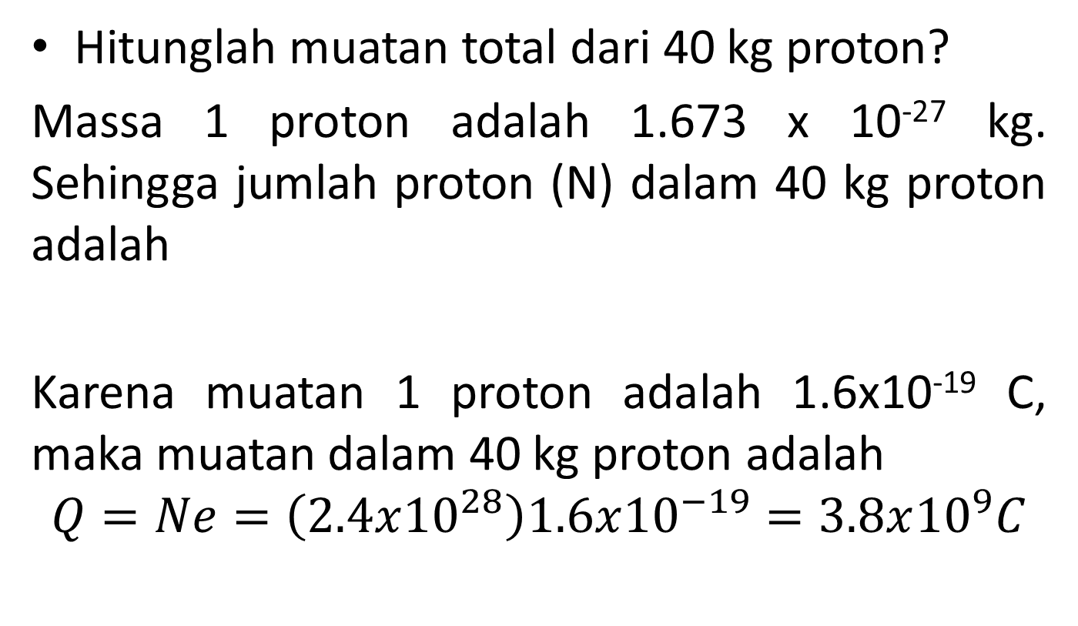
Example
Hitunglah muatan total dari 40 kg proton?
Massa 1 proton adalah 1.673 x 10⁻²⁷ kg. Sehingga jumlah proton (N) dalam 40 kg proton adalah
Karena muatan 1 proton adalah 1.6x10⁻¹⁹ C, maka muatan dalam 40 kg proton adalah
$$Q=Ne=\left(2.4x{10}^{28}\right)1.6x{10}^{−19}=3.8x{10}^{9}C$$
$$N=\frac{40}{1.673x{10}^{−27}}=23.91x{10}^{27}=2.4x{10}^{28}proton$$

Slide 12
Where do charges come from?
Rubbing materials does NOT create electric charges. It just transfers electrons from one material to the other.

Slide 13
Type of materials
Conductors
  Materials that allow electrons to flow through them easily
  Materials, such as metals
Insulators
  Materials that do NOT allow electrons to flow through them easily.
  Materials, such as rubber and glass
Semiconductors
  Materials has an electrical conductivity value between a conductor and isolator
  Materials, such as silicon and germanium

Slide 14
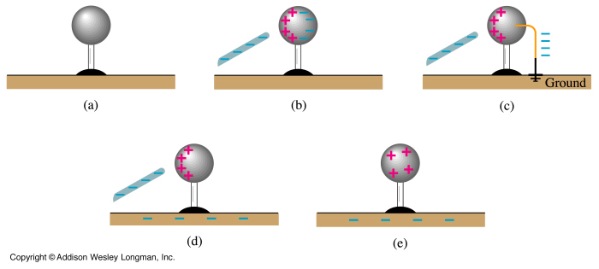
CHARGING A METAL SPHERE BY INDUCTION
Charges are free to move in a conductor but are tightly bound in an insulator.
The earth (“ground”) is a large conductor having many free charges.
Notes:
22-4 Charging a metal sphere by induction

Slide 15

Electric Force
As with all forces, the electric force is a Vector
So we rewrite Coulomb’s Law as
This gives the force on charged object 2 due to charged object 1
q₁
q₂
is a unit vector pointing from object 1 to object 2
The direction of the force is either parallel or antiparallel to this unit vector depending upon the relative signs of the charges

Slide 16
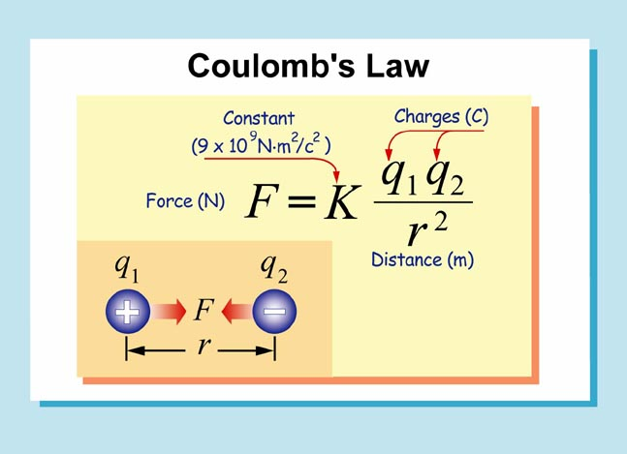

Slide 17
Superposition of Forces
If there are more than two charged objects interacting with each other
The net force on any one of the charged objects is
The vector sum of the individual Coulomb forces on that charged object

Slide 18
Example
Tiga muatan positif diletakkan pada koordinat (0,0), (4,0), dan (9,0) dari suatu sistem koordinat. Satuan sistem koordinat dalam meter. Besar muatan tersebut berturut-turut 3μC, 6μC, dan 9μC. Hitunglah gaya yang bekerja pada muatan 6μC!

