Slide 1
Electromagnetic Induction
Wenny Maulina

Slide 2
Magnetic Flux Density
Δφ
Magnetic flux lines Φ are continuous and closed.
ΔA
Direction is that of the B vector at any point.
Magnetic Flux density:
When area A is perpendicular to flux:
The unit of flux density is the weber.

Slide 3
Calculating Flux When Area is Not Perpendicular to Field
The flux penetrating the area A when the normal vector n makes an angle of θ with the B-field is:
n
A
θ
α
B
The angle θ is the complement of the angle α that the plane of the area makes with B field. (Cos θ = Sin α)

Slide 4
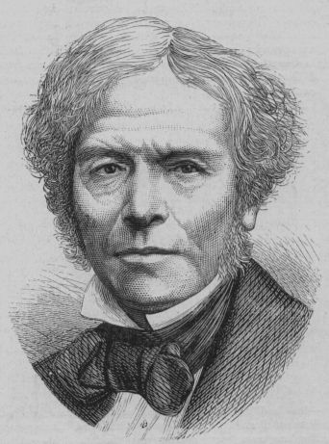
What is EM Induction?
Electromagnetic Induction is the process of using magnetic fields to produce voltage, and in a complete circuit, a current.
Michael Faraday first discovered it, using some of the works of Hans Christian Oersted. His work started at first using different combinations of wires and magnetic strengths and currents, but it wasn't until he tried moving the wires that he got any success.
It turns out that electromagnetic induction is created by just that - the moving of a conductive substance through a magnetic field.

Slide 5
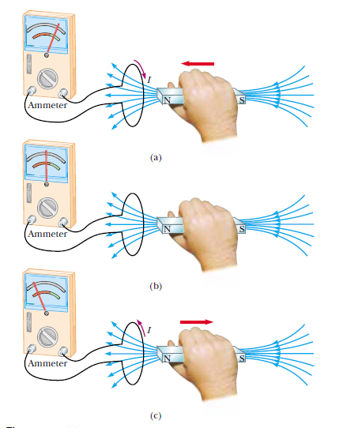
Faraday’s Experiments

Slide 6
Electromagnetic Induction Faraday’s Law
The induced emf in a circuit is proportional to the rate of change
of magnetic flux, through any surface bounded by that circuit.
ε = - dΦ_{B} / dt

Slide 7
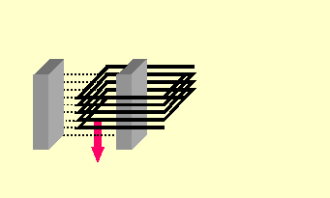
Induced EMF: Observations
B
Faraday’s observations:
Flux lines Φ in Wb
Relative motion induces emf.
Direction of emf depends on direction of motion.
Emf is proportional to rate at which lines are cut (v).
Emf is proportional to the number of turns N.
N turns; velocityv
Faraday’s Law:
The negative sign means that E opposes its cause.

Slide 8
Lenz’s Law
Lenz’s law: An induced current will be in such a direction as to produce a magnetic field that will oppose the motion of the magnetic field that is producing it.
Induced B
Induced B
Left motion
I
Right motion
N
S
N
S
I
Flux increasing to left induces loop flux to the right.
Flux decreasing by right move induces loop flux to the left.

Slide 9
Example
A coil has 200 turns of area 30 cm². It flips from vertical to horizontal position in a time of 0.03 s. What is the induced emf if the constant B-field is 4 mT?
N = 200 turns
n
θ
N
S
B
B = 4 mT; 0⁰ to 90⁰

Slide 10
A coil has 200 turns of area 30 cm². It flips from vertical to horizontal position in a time of 0.03 s. What is the induced emf if the constant B-field is 4 mT?
N = 200 turns
ΔA = 30 cm² – 0 = 30 cm²
n
ΔΦ = B ΔA = (4 mT)(30 cm²)
θ
N
S
B
ΔΦ = (0.004 T)(0.0030 m²)
ΔΦ = 1.2 x 10⁻⁵ Wb
B = 4 mT; 0⁰ to 90⁰
E = -0.080 V
The negative sign indicates the polarity of the voltage.

Slide 11
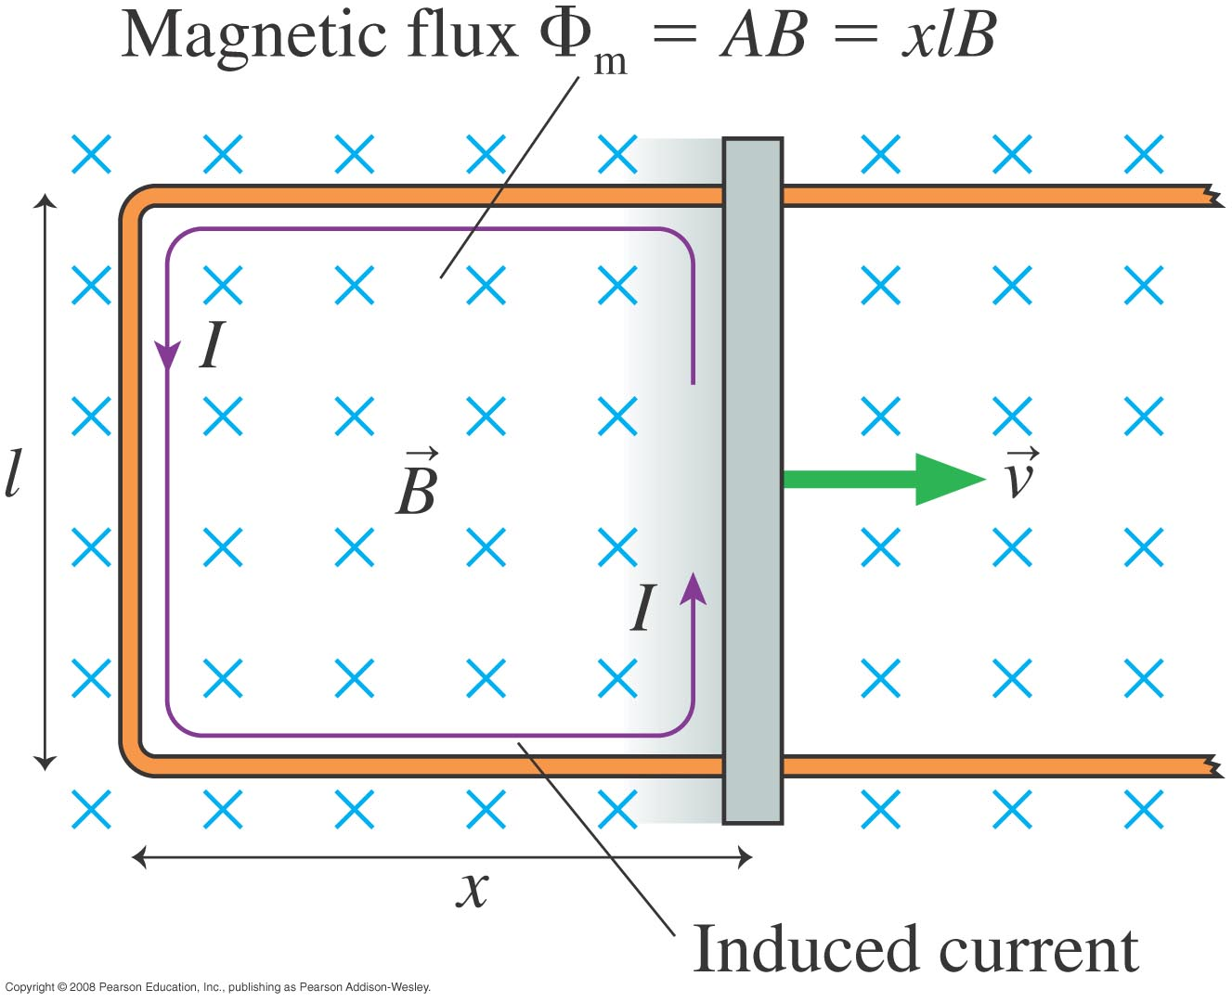
Faraday’s Law example – Changing area of loop

Slide 12
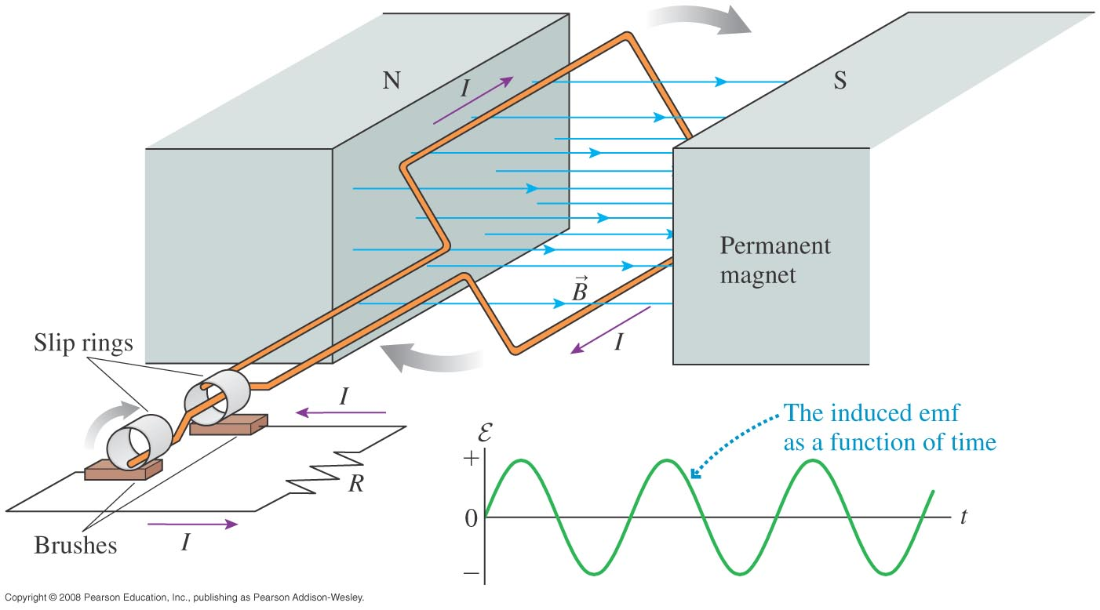
Faraday’s Law example – Changing Orientation of Loop: Generators
Assume loop rotates at constant angular frequency:

