Slide 1
Inductance inductor
Wenny Maulina

Slide 2
Inductors
An inductor can be used to produce a desired magnetic field.
An inductor in a circuit is denoted by this symbol:
An inductor satisfies the formula:
If we establish a current i in the windings (turns) of the solenoid which can be treated as our inductor, the current produces a magnetic flux Φ_{B} through the central region of the inductor. The inductance of the inductor is then
L is the inductance
Measured in Henrys (H)
L

Slide 3
Inductance of a Solenoid:
Consider a long solenoid of cross-sectional area A, with number of turns N, and of length l. The flux is
Here n is the number of turns per unit length.
The magnitude of B is given by:
Therefore,
The inductance per unit length near the center is therefore:

Slide 4
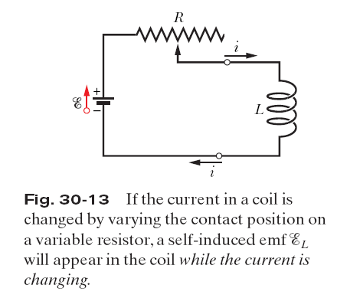
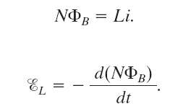
Self-Induction:

Slide 5
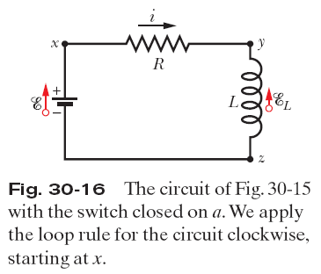
Energy Stored in a Magnetic Field:
This represents the total energy stored by an inductor L carrying a current i.

Slide 6
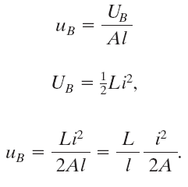
Energy Density of a Magnetic Field:
Consider a length l near the middle of a long solenoid of cross-sectional area A carrying current i; the volume associated with this length is Al.

Slide 7
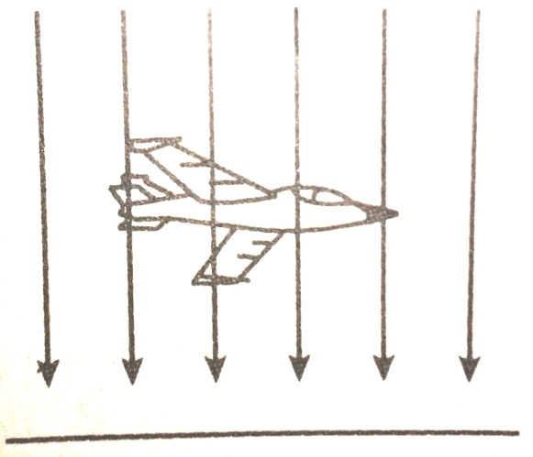
Sebuah solenoida yang terdiri dari 300 lilitan dengan panjang 40 cm dan luas penampang 6 cm² dialiri arus 2 A. Hitung fluks magnetik yang melewati solenoida!
Suatu solenoida mempunyai 1000 lilitan dan berjari-jari 1 cm.
Hitunglah induktansi diri solenoida jika panjang solenoida 25 cm
Jika arus yang mengalir dalam solenoida naik dengan laju 100 A/s. Hitunglah ggl induksi yang ditimbulkan
Sebuah pesawat jet terbang dengan kecepatan 720 km/jam. Hitung ggl induksi antara kedua ujung sayapnya yang panjangnya 12 m, jika medan magnetik bumi arah vertikal sebesar 5x10⁻⁵ T.

