Slide 1
Electrostatics
Wenny Maulina

Slide 2
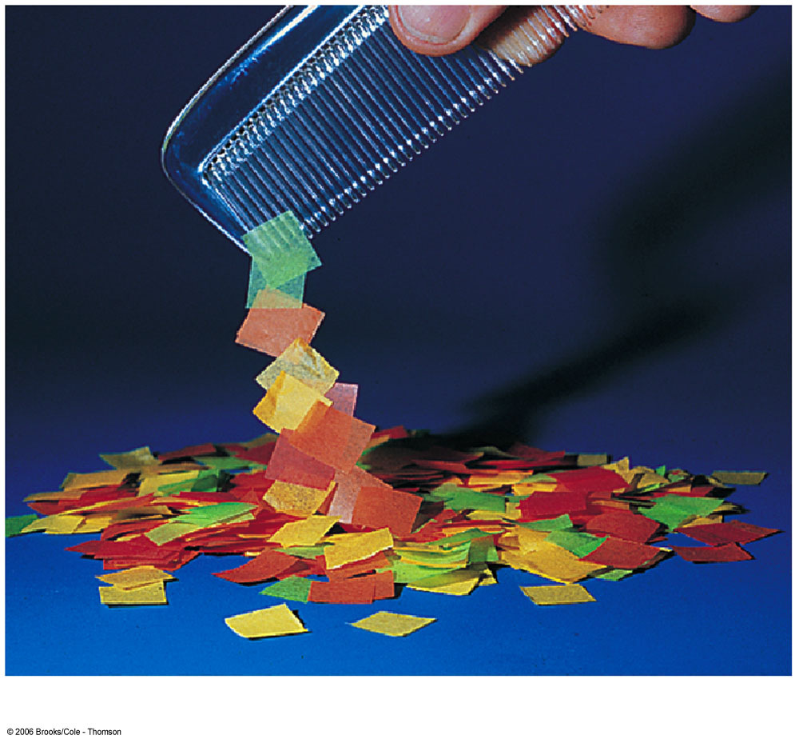

Slide 3
Electric charge
Protons have positive charge
Electrons have negative charge
Opposite signs attract
Similar signs repel
Electric field – used to calculate force between charges

Slide 4
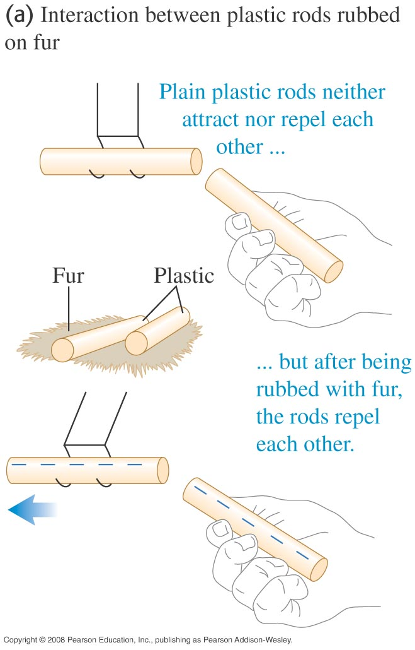

Slide 5
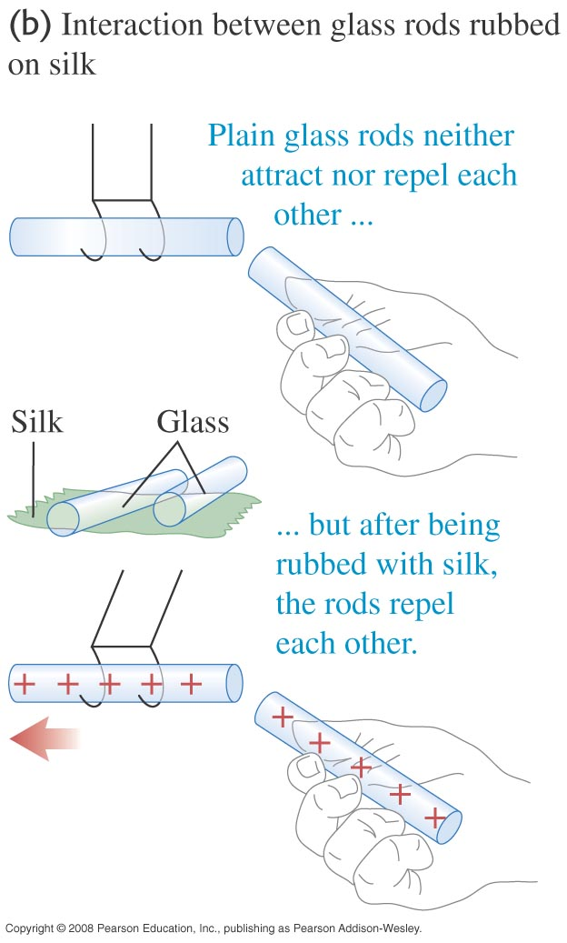

Slide 6
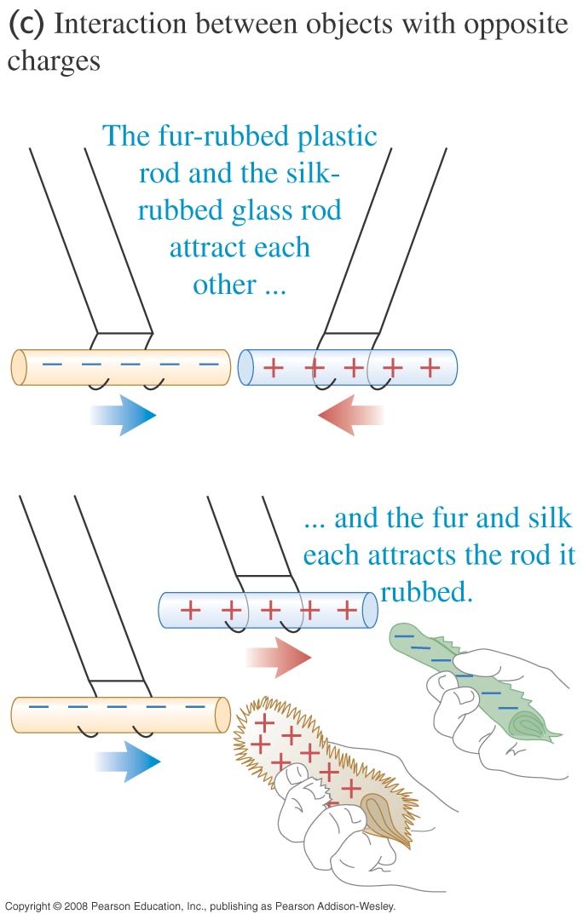

Slide 7
Where do charges come from?
Matter is made up of atoms.
+
Proton (positive charge)
–
neutron (neutral)
+
+
+
–
electron (negative charge)
–
–
atom
nucleus

Slide 8
Where do charges come from?
If electrons = protons ⇒neutral
If electrons > protons ⇒ gaining electrons, negative charge
If electrons < protons ⇒ losing electrons, positive charge

Slide 9
Electric Charge
The unit of electric charge is the coulomb (C).
The smallest amount of charge that can be added or removed from an object is the elementary charge, e = 1.6 × 10⁻¹⁹ C.
The charge of a proton is +e, an electron -e.
The charge of an object, Q, is always a multiple of this elementary charge: Q = N e, where N is an integer.

Slide 10
Example
Hitunglah muatan total dari 40 kg proton?

Slide 11
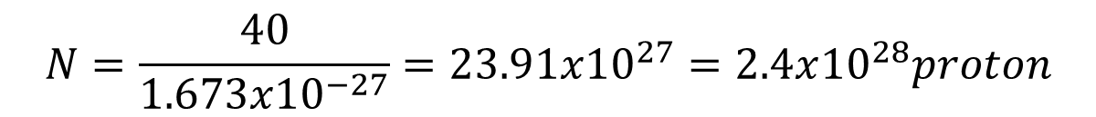
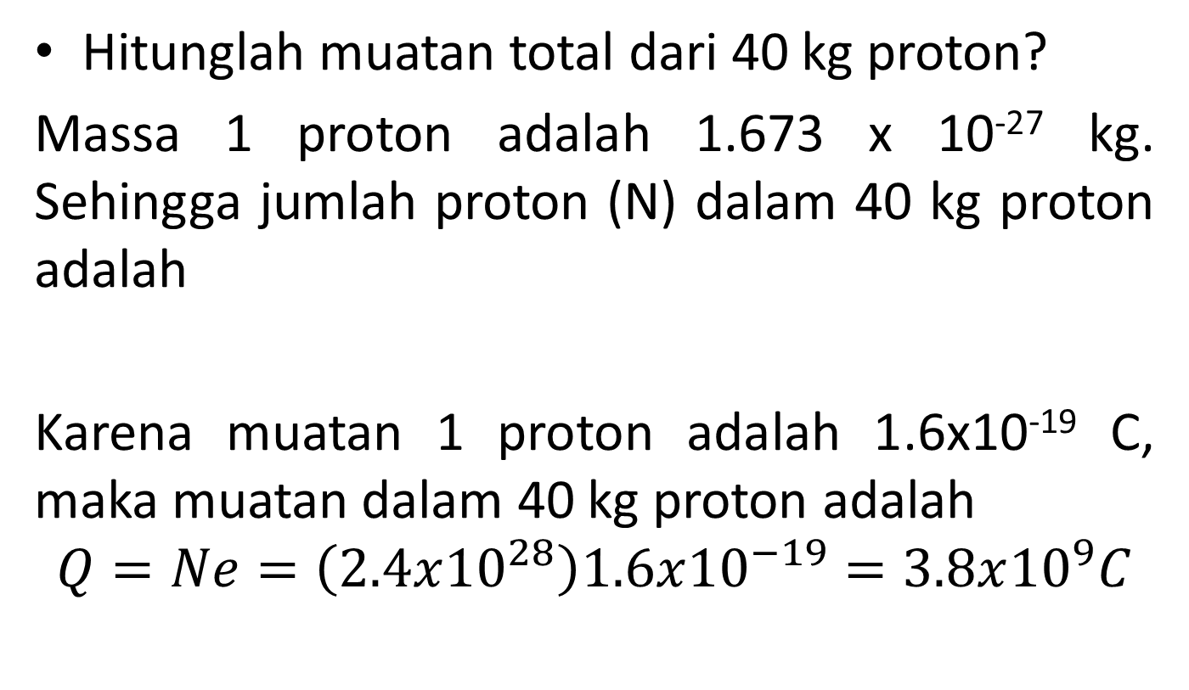
Example
Hitunglah muatan total dari 40 kg proton?
Massa 1 proton adalah 1.673 x 10⁻²⁷ kg. Sehingga jumlah proton (N) dalam 40 kg proton adalah
Karena muatan 1 proton adalah 1.6x10⁻¹⁹ C, maka muatan dalam 40 kg proton adalah
$$Q=Ne=\left(2.4x{10}^{28}\right)1.6x{10}^{−19}=3.8x{10}^{9}C$$
$$N=\frac{40}{1.673x{10}^{−27}}=23.91x{10}^{27}=2.4x{10}^{28}proton$$

Slide 12
Where do charges come from?
Rubbing materials does NOT create electric charges. It just transfers electrons from one material to the other.

Slide 13
Type of materials
Conductors
  Materials that allow electrons to flow through them easily
  Materials, such as metals
Insulators
  Materials that do NOT allow electrons to flow through them easily.
  Materials, such as rubber and glass
Semiconductors
  Materials has an electrical conductivity value between a conductor and isolator
  Materials, such as silicon and germanium

Slide 14
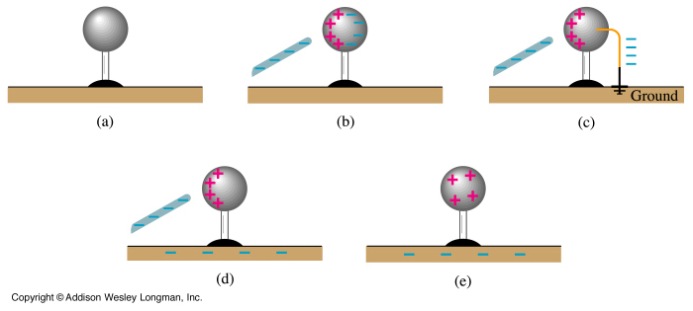
CHARGING A METAL SPHERE BY INDUCTION
Charges are free to move in a conductor but are tightly bound in an insulator.
The earth (“ground”) is a large conductor having many free charges.
Notes:
22-4 Charging a metal sphere by induction

Slide 15

Electric Force
As with all forces, the electric force is a Vector
So we rewrite Coulomb’s Law as
This gives the force on charged object 2 due to charged object 1
q₁
q₂
is a unit vector pointing from object 1 to object 2
The direction of the force is either parallel or antiparallel to this unit vector depending upon the relative signs of the charges

Slide 16
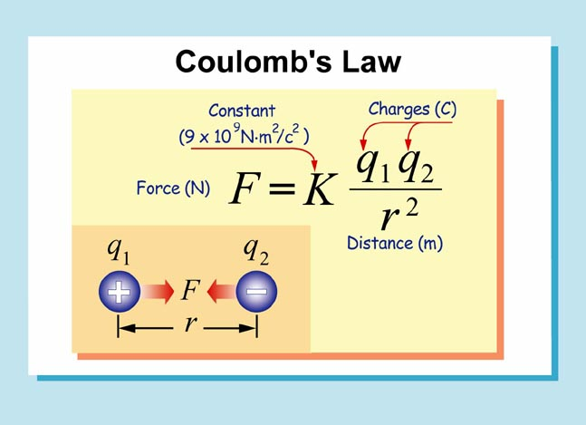

Slide 17
Superposition of Forces
If there are more than two charged objects interacting with each other
The net force on any one of the charged objects is
The vector sum of the individual Coulomb forces on that charged object

Slide 18
Example
Tiga muatan positif diletakkan pada koordinat (0,0), (4,0), dan (9,0) dari suatu sistem koordinat. Satuan sistem koordinat dalam meter. Besar muatan tersebut berturut-turut 3μC, 6μC, dan 9μC. Hitunglah gaya yang bekerja pada muatan 6μC!

Slide 19
Electric Field
Like the electric force, the electric field is also a vector
If there is an electric force acting on an object having a charge q_{o}, then the electric field at that point is given by
(with the sign of q₀ included)

Slide 20
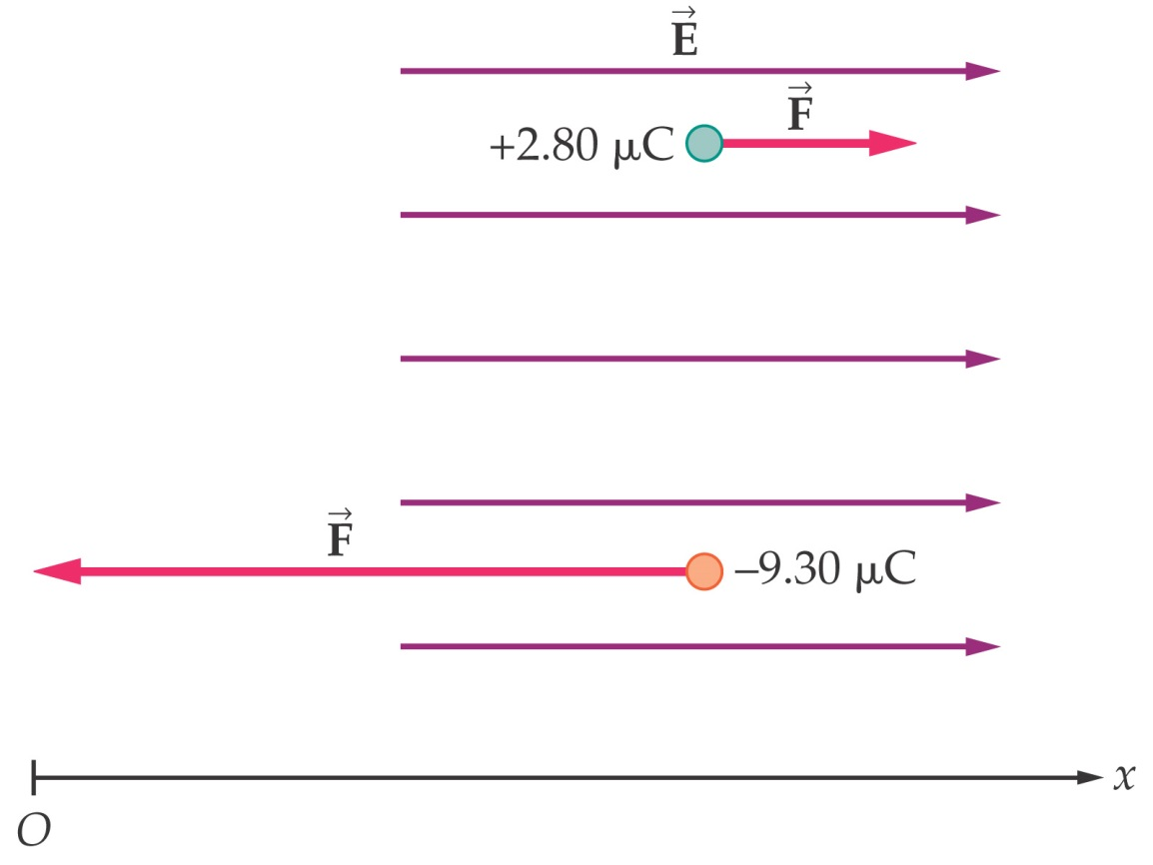
Electric Field
If we know the electric field, we can calculate the force on any charge:
The direction of the force depends on the sign of the charge – in the direction of the field for a positive charge, opposite to it for a negative one.

Slide 21
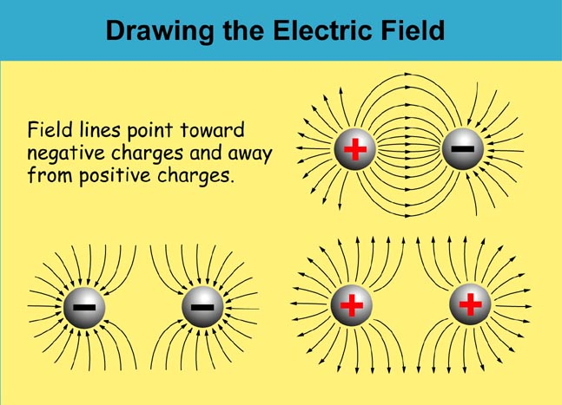

Slide 22
Electric Field
Earlier we saw that the force on a charged object is given by
The term in parentheses remains the same if we change the charge on the object at the point in question
The quantity in the parentheses can be thought of as the electric field at the point where the test object is placed
The electric field of a point charge can then be shown to be given by

Slide 23
Electric Field
As with the electric force, if there are several charged objects, the net electric field at a given point is given by the vector sum of the individual electric fields

Slide 24
We can use our notion of the
gravitational field to form the concept of an
ELECTRIC FIELD (E)
Recall force between two masses: F = m g
g is the gravitational field (9.8 m/sec²)
| F | = G | M m | / r²
The force between two charges Q and q_{o} is given by: F = q_{o} E
| F | = k | Q q_{o} | / r²
Notes:
See next slide (repeat…)

Slide 25
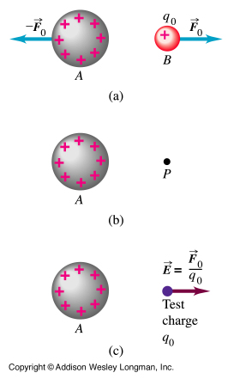
Coulomb’s Law:
| F | = k | Q q_{o} | / r²
Rearranged:
| F | = | q_{o} [k Q/r²] |
Gives us:
F = q_{o} E
where the electric field E is:
| E | = | k Q / r² |

Slide 26
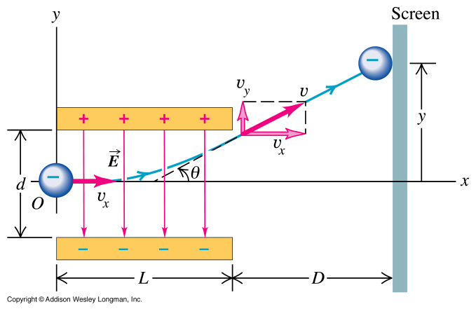
Forces on electron beam in a TV tube (CRT)
F = Q E and F = m g (vector equations)
Notes:
24-22 Forces in a TV tube

Slide 27

Example
Hitung besarnya kuat medan listrik pada titik C yang terletak di antara titik A dan B yang berjarak 5 cm dari muatan A $\left(q_{A}=10μC\right)$ dan 8 cm dari B $\left(q_{B}=6μC\right)$

Slide 28
Example
Sebuah elektron ditembakkan ke dalam medan listrik homogen E= 2000 N/C dengan kecepatan awal V₀ = 10⁶ m/s tegak lurus medan. (a) bandingkan gaya listrik yang bekerja pada elektron dengan gaya gravitasi yang bekerja padanya, (b) seberapa jauh elektron dibelokkan setelah menempuh jarak 1 cm pada arah sumbu x.
E
V₀
-
q

Slide 29
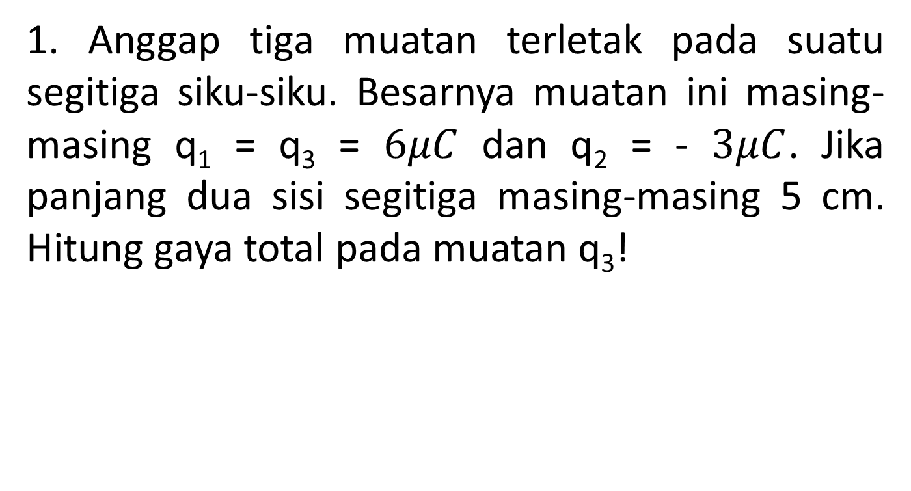
Exercise
1. Anggap tiga muatan terletak pada suatu segitiga siku-siku. Besarnya muatan ini masing-masing q₁ = q₃ = $6μC$ dan q₂ = - $3μC$. Jika panjang dua sisi segitiga masing-masing 5 cm. Hitung gaya total pada muatan q₃!
q₁
5 cm
q₂
5 cm
q₃

Slide 30
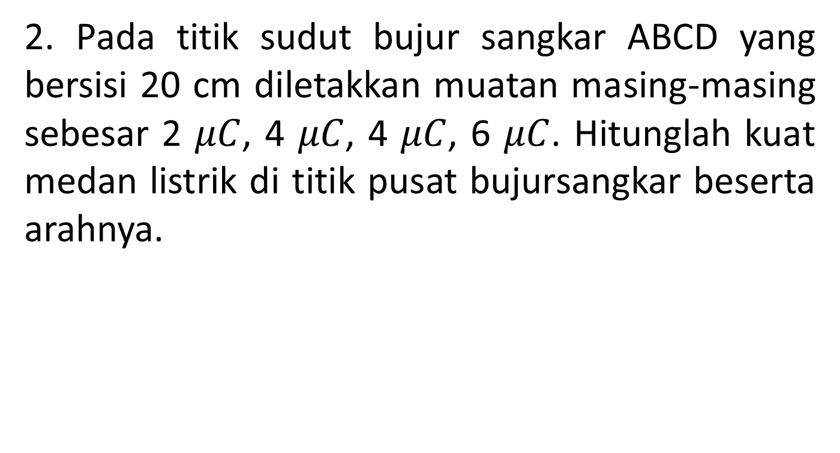
Exercise
2. Pada titik sudut bujur sangkar ABCD yang bersisi 20 cm diletakkan muatan masing-masing sebesar 2 $μC$, 4 $μC$, 4 $μC$, 6 $μC$. Hitunglah kuat medan listrik di titik pusat bujursangkar beserta arahnya.
A
B
D
C

