Slide 1
Electric Field
Wenny Maulina

Slide 2
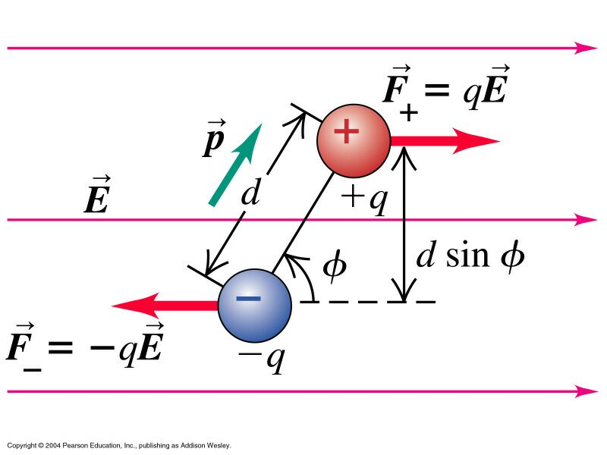
Electric Dipole
A pair of equal and opposite charges q
separated by a displacement d is called an electric dipole. It has an electric dipole moment p=qd.
Given a uniform external field
Then since the charges are of equal magnitude, the force on each charge has the same value
However the forces are in opposite directions!
Therefore the net force on the dipole is F_{net} = 0

Slide 3
Torque on a Dipole
The individual forces acting on the dipole may not necessarily be acting along the same line.
If this is the case, then there will be a torque acting on the dipole, causing the dipole to rotate.
The torque is then given by τ = qE dsinφ
d is a vector pointing from the negative charge to the positive charge

Slide 4
Potential Energy of a Dipole
Given a dipole in an external field:
Dipole will rotate due to torque
Electric field will do work
The work done is the negative of the change in potential energy of the dipole
The potential energy can be shown to be

Slide 5
Example
Sebuah dipol listrik terdiri dari dua muatan yang berlawanan besarnya q = 1 x 10⁻⁶ C dan terpisah satu sama lain d = 2 cm. Dipol tersebut ditempatkan di dalam sebuah medan luar yang besarnya 1 x 10⁵ N/C. Tentukan (a) Besarnya momen gaya (torka) maksimum yang dikerahkan oleh medan pada dipol (b) Kerja yang harus dilakukan oleh sebuah pengaruh luar untuk memutar ujung dipol menjadi ujung lainnya, dengan memulai dari kedudukan sejajar (θ = 0)

Slide 6
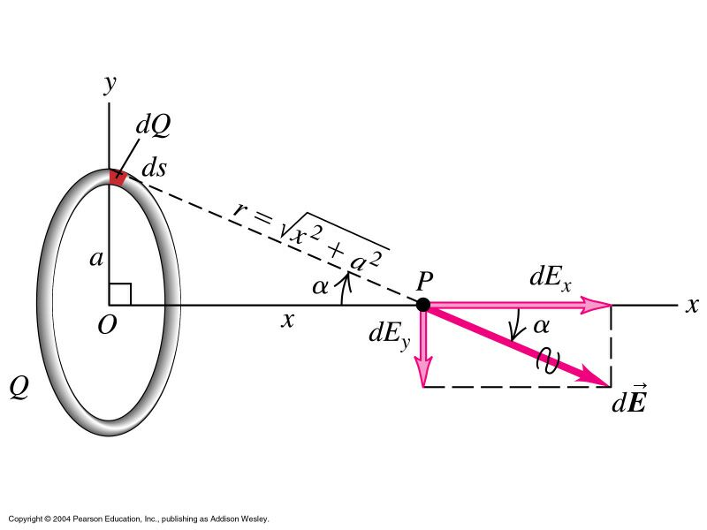
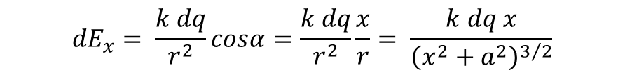
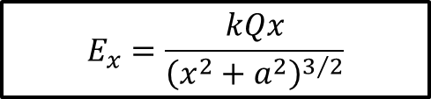
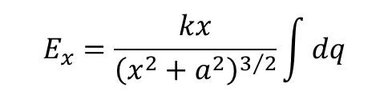
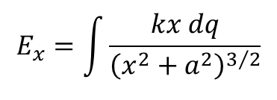
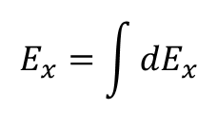
Electric Field
Ring of Charge
$${dE}_{x}= \frac{k dq}{r^{2}}cosα=\frac{k dq}{r^{2}}\frac{x}{r}= \frac{k dq x}{{\left(x^{2}+a^{2}\right)}^{3/2}}$$
$$E_{x}=\int{{dE}_{x}}$$
$$E_{x}=\int{\frac{kx dq}{{\left(x^{2}+a^{2}\right)}^{3/2}}}$$
$$E_{x}=\frac{kx}{{\left(x^{2}+a^{2}\right)}^{3/2}}\int{dq}$$
$$E_{x}=\frac{kQx}{{\left(x^{2}+a^{2}\right)}^{3/2}}$$

Slide 7
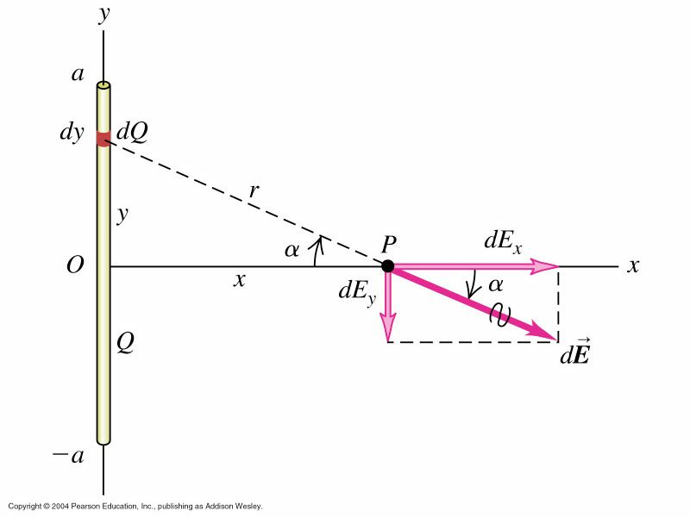


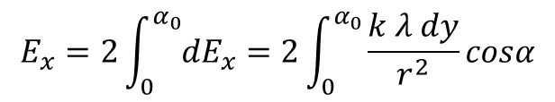
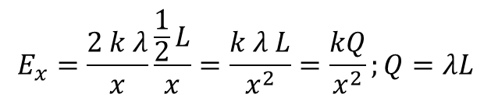

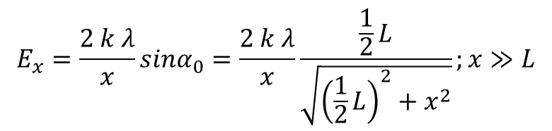

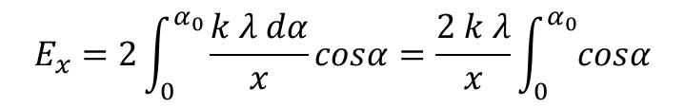
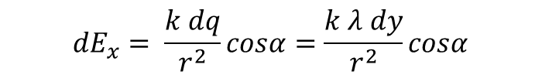
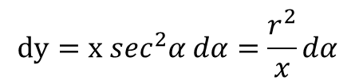
Electric Field
Line of Charge
$$dq=λ dy$$
$${dE}_{x}= \frac{k dq}{r^{2}}cosα=\frac{k λ dy}{r^{2}}cosα$$
$$E_{x}=2\int_{0}^{α_{0}}{{dE}_{x}}=2\int_{0}^{α_{0}}{\frac{k λ dy}{r^{2}}}cosα$$
$$α_{0}$$
$$y=x tanα$$
$$\frac{1}{2}L$$
$$dy=x \sec^{2}α dα=\frac{r^{2}}{x}dα$$
$$E_{x}=2\int_{0}^{α_{0}}{\frac{k λ dα}{x}}cosα=\frac{2 k λ}{x}\int_{0}^{α_{0}}{cosα}$$
$$E_{x}=\frac{2 k λ}{x}sinα_{0}=\frac{2 k λ}{x}\frac{\frac{1}{2}L}{\sqrt{{\left(\frac{1}{2}L\right)}^{2}+x^{2}}};x≫L$$
$$E_{x}=\frac{2 k λ}{x}\frac{\frac{1}{2}L}{x}=\frac{k λ L}{x^{2}}=\frac{kQ}{x^{2}};Q=λL$$

Slide 8
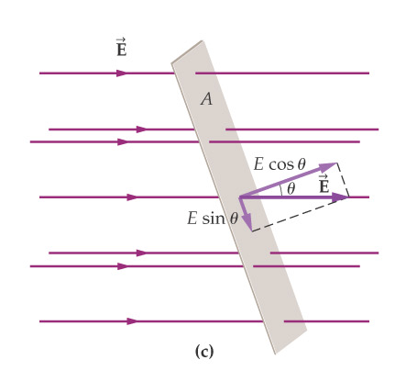
Electric Flux and Gauss’s Law
Electric flux is a measure of the electric field perpendicular to a surface:

Slide 9
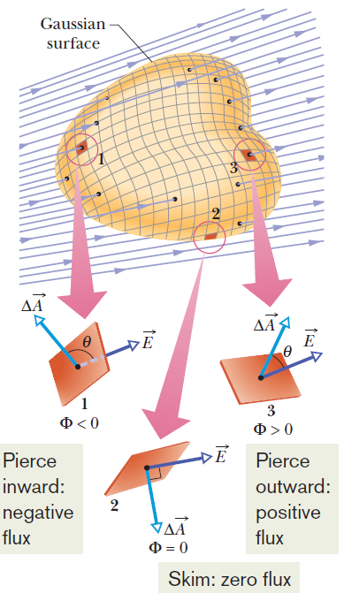


The electric flux through a surface is defined to be the inner product of the electric field and the surface vector:
For a closed surface, it is

Slide 10
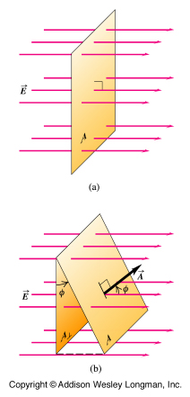
(a) The electric flux through the surface = EA.
(b) When the area vector makes an angle φ with the vector E, the area projected onto a plane oriented perpendicular to the flow is A perp. = A cos φ. The flux is zero when φ = 90º because the rectangle lies in a plane parallel to the flow and no fluid flows through the rectangle
A flat surface in a uniform electric field.

Slide 11
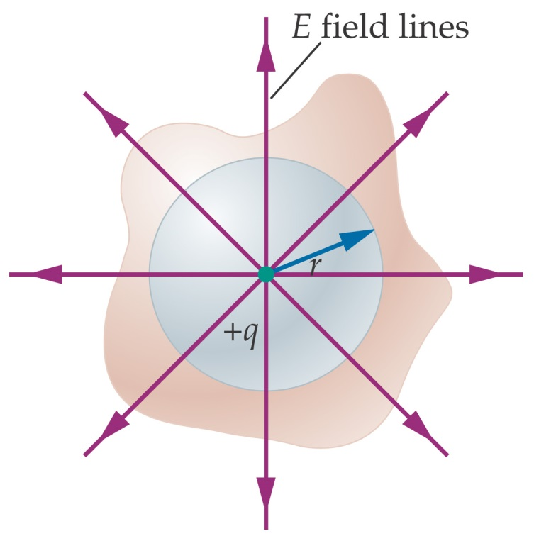
Electric Flux and Gauss’s Law
Gauss’s law states that the electric flux through a closed surface is proportional to the charge enclosed by the surface:

Slide 12
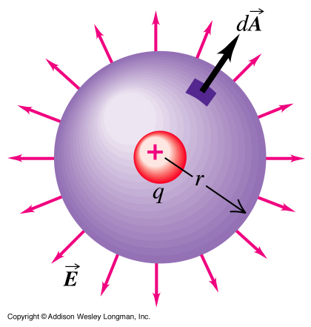
Φ_{E} = ∫ E . dA
= ∫ E dA cos φ
= ∫ E dA = E ∫ dA
= E (4p R²)
= (1/4p ε_{o}) q /R²) (4π R²)
= q / ε_{o}.
So the electric flux
Φ_{E} = q / ε_{o}.
Now we can write Gauss's Law:
Φ_{E} = ∫ E . dA =
∫ |EdA| cos φ =Qencl /ε_{o}
Electric FLUX through a sphere
centered on a point charge q.

Slide 13
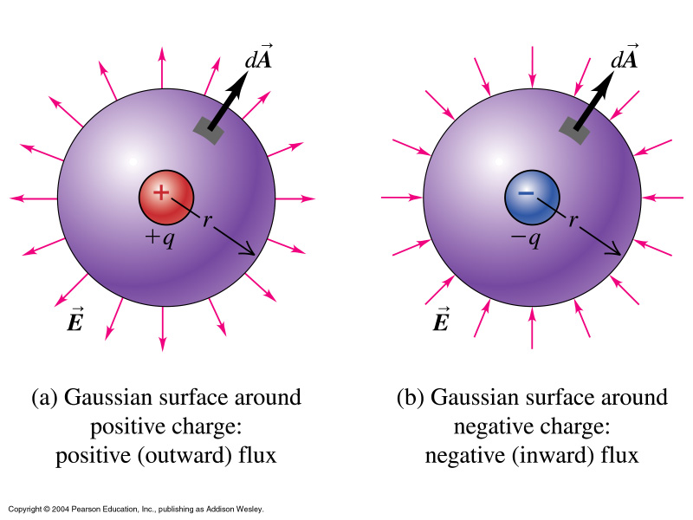
Spherical Gaussian surfaces around
(a) positive and (b) negative point charge.

Slide 14

Gauss’s Law can be used to calculate the magnitude of the E field vector:

Slide 15
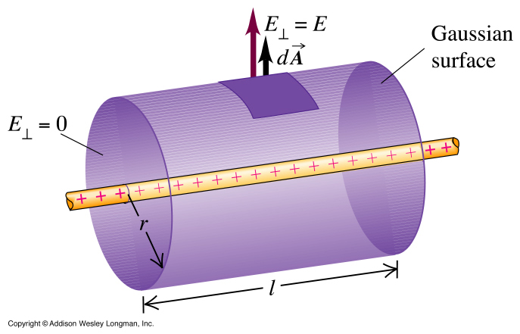
A coaxial cylindrical Gaussian surface is used to find the electric field outside an
infinitely long charged wire.

Slide 16
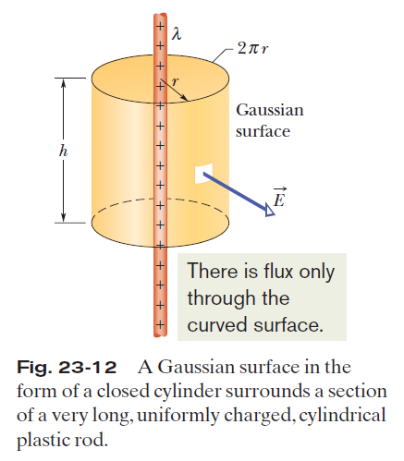
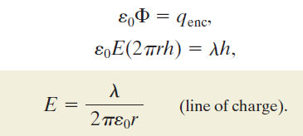
Applying Gauss’ Law and Cylindrical Symmetry:

Slide 17
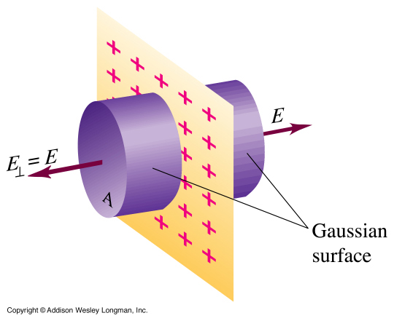
A cylindrical Gaussian surface is used to find the electric field of an
infinite plane sheet of charge.

Slide 18
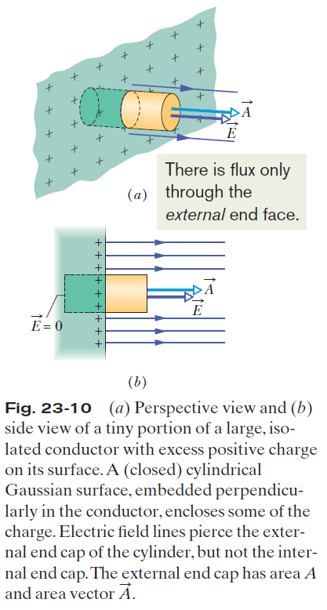


A Charged Isolated Conductor; The External Electric Field:
is the charge per unit area.
q_{enc} is equal to σA.

Slide 19
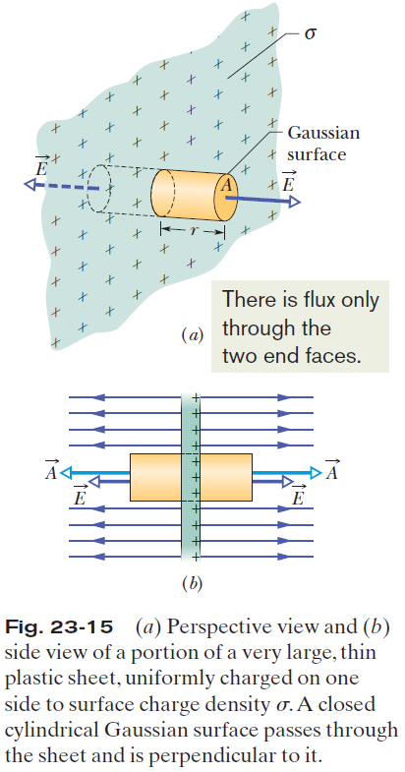
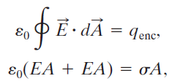

Applying Gauss’ Law, Planar Symmetry
Non-conducting Sheet:

Slide 20
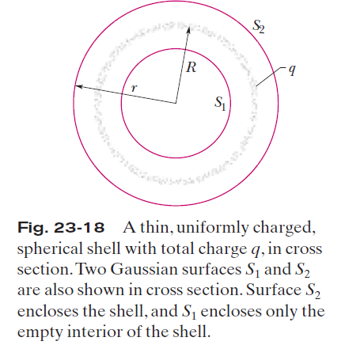
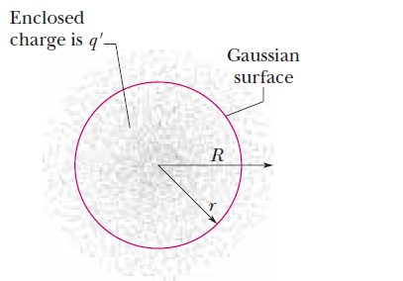



Applying Gauss’ Law, Spherical Symmetry:
Fig. 23-19 The dots represent a spherically symmetric distribution of charge of radius R, whose volume charge density ρ is a function only of distance from the center. The charged object is not a conductor, and therefore the charge is assumed to be fixed in position. A concentric spherical Gaussian surface with r >R is shown.

Slide 21
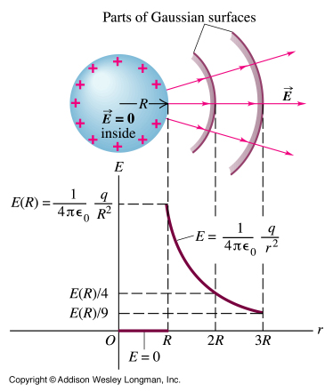
Under electrostatic conditions the electric field inside a solid conducting sphere is zero. Outside the sphere the electric field drops off as 1 / r², as though all the excess charge on the sphere were concentrated at its center.
Electric field = zero (electrostatic)
inside a solid conducting sphere

Slide 22
Example
Suatu bola konduktor (q = 10 μC) berjari-jari 10 cm ditempatkan diruang hampa. Hitung kuat medan listrik di titik yang berjarak r₁, r₂, dan r₃ dari pusat konduktor jika: a) r₁ = 15 cm, b) r₂ = 10 cm, dan c) r₃ = 5 cm

Slide 23






Exercise
Suatu dipol listrik terdiri dari 1 muatan positif +q dan 1 muatan negatif –q yang terpisah pada jarak 2d. Hitung kuat medan listrik pada titik P yang berjarak y dari pusat dipol. Anggap y >> d
$$p$$
$$y$$
$$θ$$
$$θ$$
$$+q$$
2d
$$−q$$

Slide 24
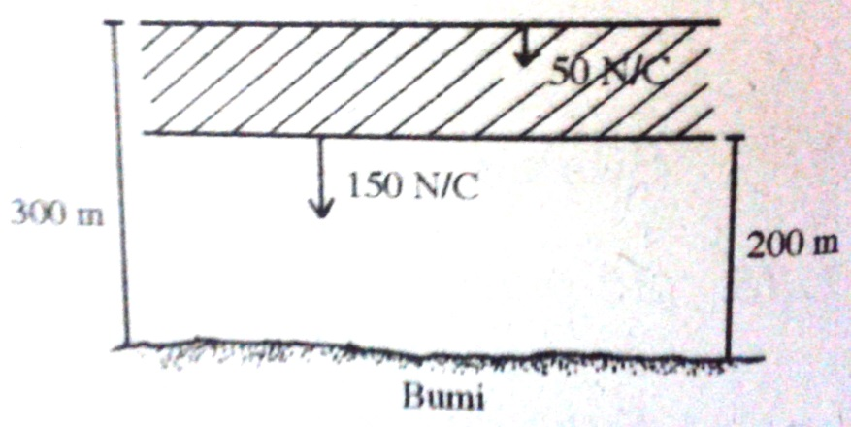
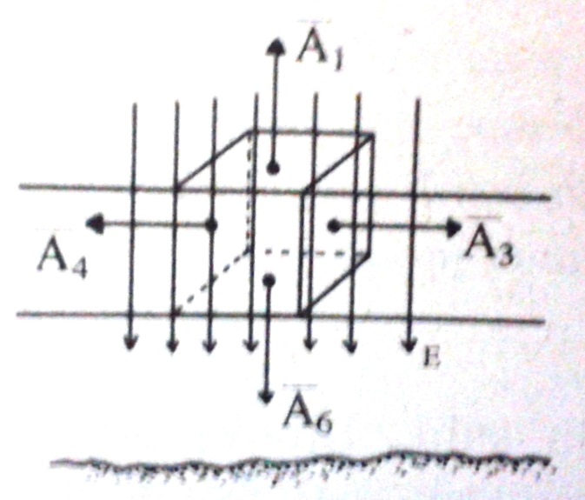
Exercise
Menurut hasil eksperimen, medan listrik di suatu tempat tertentu di atmosfer bumi arahnya ke bawah. Pada ketinggian 300 m besar kuat medannya 50 N/C. Sedangkan pada ketinggian 200 m besarnya 150 N/C. Hitung jumlah muatan total dalam sebuah kubus yang sisinya terletak pada ketinggian 200 m dan 300 m. Abaikan kelengkungan bumi!

