Slide 1
Electric Potential
Wenny Maulina

Slide 2
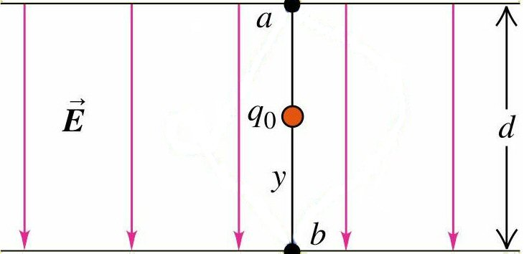
Work Done by Uniform Electric Field
Force on charge is
Work is done on the
charge by field
The work done is independent of path taken from point a to point b because
The Electric Force is a conservative force

Slide 3
Electric Potential Energy
The work done by the force is the same as the change in the particle’s potential energy
The work done only depends upon the change in position

Slide 4
Absolute Potential Energy
Absolute P.E. is relative to ∞.
r_{b}
+
Β
Α
F
+
∞
It is work to bring +q from infinity to point near Q—i.e., from ∞ to r_{b}
+
+
+
•
•
Q
+
+
+
qE
+
r_{a}
$$Work=kQq\left(\frac{1}{r_{b}}−\frac{1}{∞}\right)=kQq\frac{1}{r_{b}}$$
Absolute Potential Energy:

Slide 5
Example, Work and potential energy in an electric field:

Slide 6
Electric Potential
The potential energy per unit charge at a point in an electric field is called the electric potential V (or simply the potential) at that point. This is a scalar quantity. Thus,
The electric potential at any point in an electric field can be defined to be
Here W is the work done by the electric field on a charged particle as that particle moves in from infinity to point f.
The SI unit for potential is the joule per coulomb. This combination is called the volt (abbreviated V).

Slide 7
Potential For Multiple Charges
The Electric Potential V in the vicinity of a number of charges is equal to the algebraic sum of the potentials due to each charge.
Q₁
r₁
-
•
A
r₂
r₃
+
Q₃
-
Q₂
Potential is + or – based on sign of the charges Q.

Slide 8
Potential Difference
The potential difference between two points A and B is the work per unit positive charge done by electric forces in moving a small test charge from the point of higher potential to the point of lower potential.
Potential Difference: V_{AB} = V_{A} - V_{B}
Work_{AB} = q(V_{A} – V_{B}) Work by E-field
The positive and negative signs of the charges may be used mathematically to give appropriate signs.

Slide 9
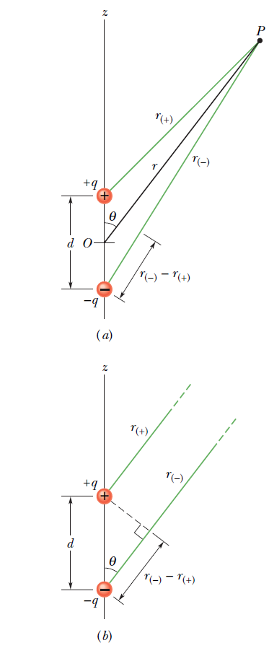
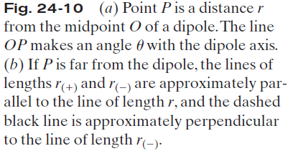
Potential Due to an Electric Dipole:

Slide 10
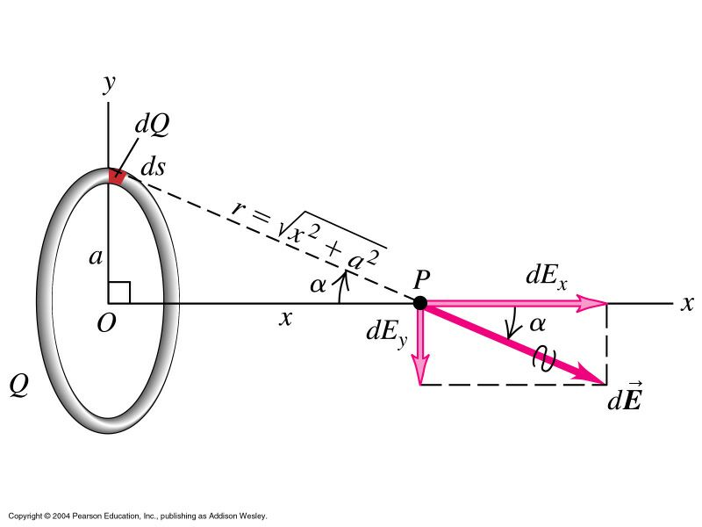
Potential Due to a Continuous Charge Distribution: Ring of Charge:
$$V=\int{\frac{k dq}{r}=\int{\frac{k dq}{\sqrt{x^{2}+a^{2}}}}}$$
P
$$V=\frac{k}{\sqrt{x^{2}+a^{2}}}\int{dq=\frac{kQ}{\sqrt{x^{2}+a^{2}}}}$$

Slide 11
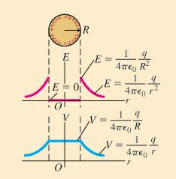
Electric Potential at Spherical Conductor

Slide 12
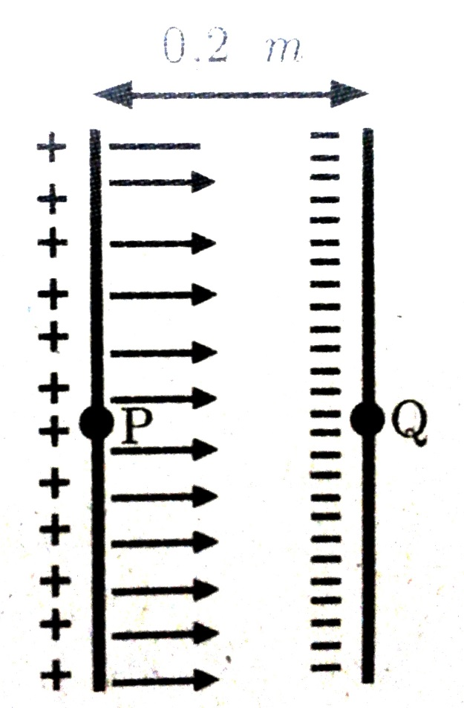
Example
Sebuah proton dilepaskan dari keadaan diam dalam medan listrik uniform 2 x 10⁴ V/m arah sumbu x. Proton bergerak dari titik P ke titik Q yang berjarak 0,2 meter. Tentukan:
Perubahan potensial listik diantara titik P dan Q
Perubahan energi potensial proton selama menempuh jarak tersebut
Kecepatan proton di titik Q

Slide 13
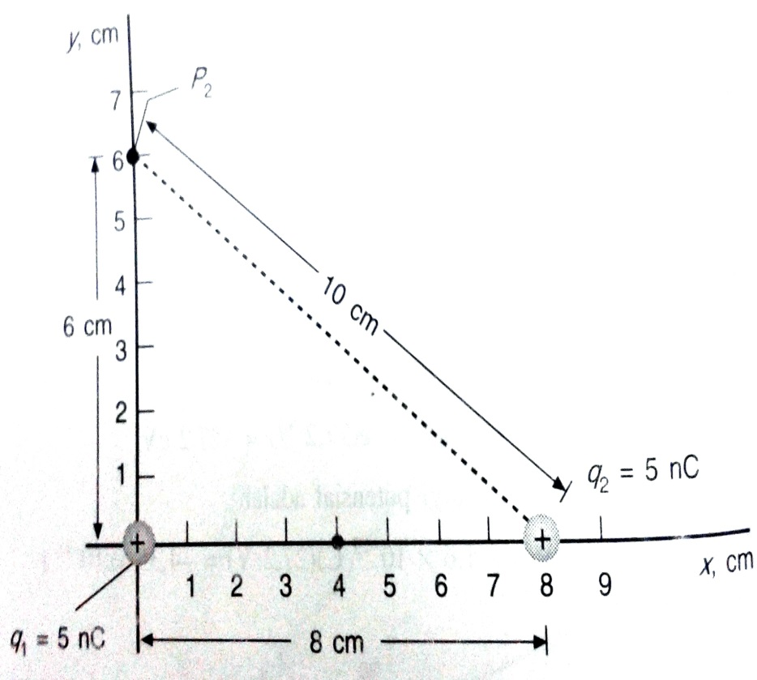
Example
Dua muatan titik positif sama besarnya +5 nC pada sumbu x satu dipusat dan yang lainnya pada x = 8 cm seperti pada gambar. Tentukan potensial di (a) titik P₁ pada sumbu x pada x = 4 cm dan (b) titik P₂ pada sumbu y di y = 6 cm.
P₁

Slide 14
Exercise
Sebuah bola konduktor bermuatan 10⁻⁶ C mempunyai jari-jari 8 cm. Hitung potensial di titik yang berjarak r₁ = 10 cm, r₂ = 8 cm, dan r₃ = 6 cm dari pusat konduktor!

Slide 15
Exercise
Cincin jari-jari 4 cm membawa muatan serba sama 8 nC. Partikel kecil dengan massa m = 6 mg dan muatan q₀ = 5 nC diletakkan pada x = 3 cm dan dilepaskan. Tentukan kecepatan muatan ketika ia berjarak jauh dari cincin.

Slide 16
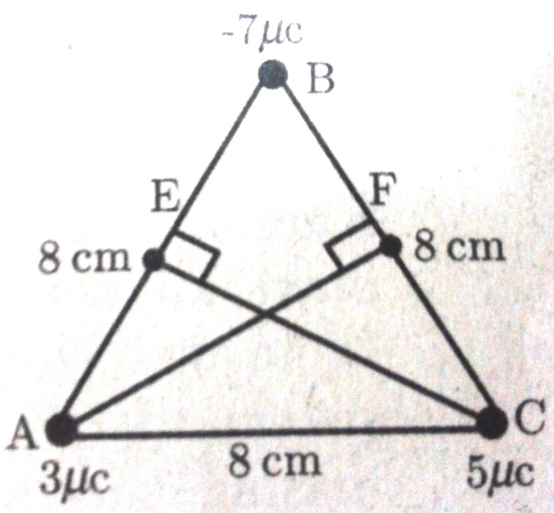
Exercise
Pada titik sudut suatu segitiga sama sisi ABC masing-masing terdapat muatan 3 μC, -7 μC, dan 5 μC, Panjang sisi segitiga 8 cm. Tentukan:
Potensial di titik E (tengah-tengan AB) dan di titik F (tengah-tengah BC)
Berapa usaha untuk memindahkan muatan 4 μC dari titik E ke F!

Slide 17
Exercise
Dalam suatu tabung hampa yang mempunyai elektroda negatif (katoda) dan elektroda positif (anoda), bergerak elektron-elektron yang dilepaskan oleh katoda yang dipanaskan. Hitung kecepatan elektron sewaktu tiba di anoda, jika kecepatan awal elektron di katoda sama dengan nol. Beda potensial antara anoda dan katoda 300 volt
―
┼
K
A
T
O
D
A
A
N
O
D
A
e
―
300 V

