Slide 1
CAPACITANCE CAPASITOR
Wenny Maulina

Slide 2
Capasitors
A capacitor is constructed of two parallel conducting plates separated by an insulator.
Conductors are commonly used as places to store charge.
Capacitance is a measure of a capacitor’s ability to store charge on its plates.
  A capacitor has a capacitance of 1 farad (F) if 1 coulomb (C) of charge is deposited on the plates by a potential difference of 1 volt across its plates.
  The farad is named after Michael Faraday, a nineteenth century English chemist and physicist.

Slide 3
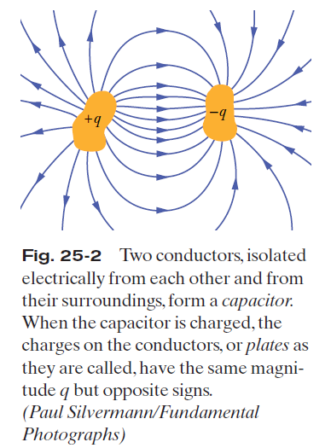
To store charge
To store energy
To control variation time scales in a circuit

Slide 4

Capacitance
The capacitance C of a capacitor is defined as the ratio of the magnitude of the charge on either conductor to the magnitude of the potential difference between the conductors:
Note that by definition capacitance is always a positive quantity. Furthermore, the charge Q and the potential difference ΔV are positive quantities. Because the potential difference increases linearly with the stored charge, the ratio Q / Δ V is constant for a given capacitor.
The SI unit of capacitance is the farad (F),

Slide 5
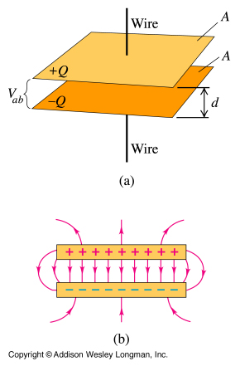
Q = C V
where C = e_{o} A / d
for a parallel plate capacitor,
where e_{o} is the permittivity of the insulating material (dielectric) between plates.
Recall that we used Gauss's Law to calculate the electric field (E) between the plates of a charged capacitor:
E = s / e_{o} where there is a vacuum between the plates.
V_{ab} = E d, so E = V_{ab} /d
A charged parallel
plate capacitor.

Slide 6
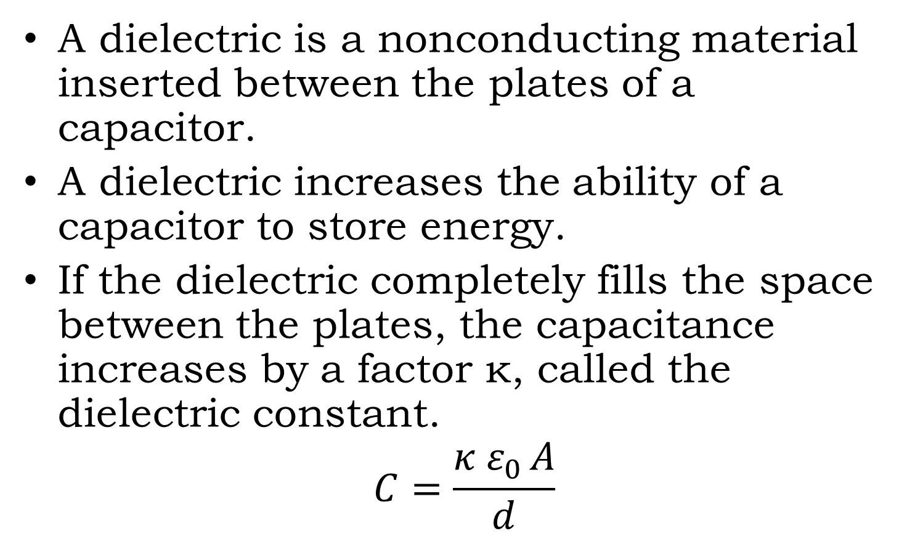
Dielectric
A dielectric is a nonconducting material inserted between the plates of a capacitor.
A dielectric increases the ability of a capacitor to store energy.
If the dielectric completely fills the space between the plates, the capacitance increases by a factor κ, called the dielectric constant.
$$C=\frac{κ{ ε}_{0 }A}{d}$$

Slide 7
From the equation for capacitance
the capacitance can be increased by decreasing the distance d between the plates.
The value of d is limited by the electrical discharge that could occur through the dielectric medium separating the plates.
For any separation d, the maximum voltage that can be applied across the capacitor plates without causing a discharge depends on the dielectric strength of the dielectric.

Slide 8
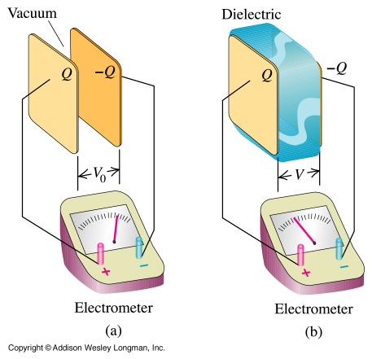
When a dielectric is inserted between the plates of a charged capacitor that is not connected to a battery (a source of additional charge), but the voltage is reduced by a factor k.

Slide 9
Capacitors in Parallel
When capacitors are joined at both ends like this, they are said to be in parallel
  They have the same voltage across them
They can be treated like a single capacitor:
V
C₁
C₂

Slide 10
Capacitors in Series
When capacitors are joined at one end, with nothing else, they are said to be in series
  They have the same charge across them
They can be treated like a single capacitor:
V
C₁
C₂

Slide 11
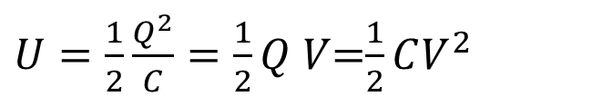
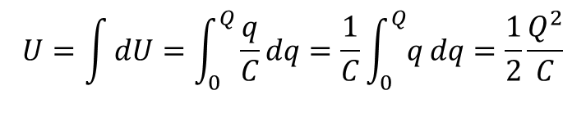
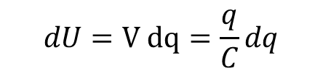
Energy Stored in an Electric Field
The potential energy of a charged capacitor may be viewed as being stored in the electric field between its plates.
Suppose that, at a given instant, a charge q′ has been transferred from one plate of a capacitor to the other. The potential difference V′ between the plates at that instant will be q′/C. If an extra increment of charge dq′ is then transferred, the increment of work. This work is store as potential energy U in the capacitor,
$$dU=V dq=\frac{q}{C}dq$$
The potential energy required to bring the total capacitor charge up to a final value q is
$$U=\int{dU}=\int_{0}^{Q}{\frac{q}{C}dq}=\frac{1}{C}\int_{0}^{Q}{q}dq=\frac{1}{2}\frac{Q^{2}}{C}$$
$U=\frac{1}{2}\frac{Q^{2}}{C}=\frac{1}{2}Q V$=$\frac{1}{2}CV^{2}$

Slide 12



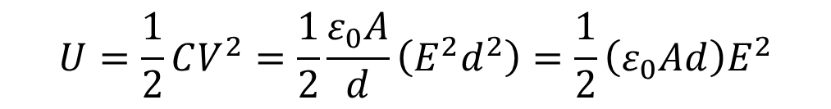
Energy Density
The potential energy per unit volume between parallel-plate capacitor is
and
$$C=\frac{ε_{0}A}{d}$$
$$V=E d$$
$$U=\frac{1}{2}CV^{2}=\frac{1}{2}\frac{ε_{0}A}{d}\left(E^{2}d^{2}\right)=\frac{1}{2}\left(ε_{0}Ad\right)E^{2}$$
Energy per volume as energy density
$$η=\frac{energi}{volume}=\frac{1}{2}ε_{0}E^{2}$$

Slide 13
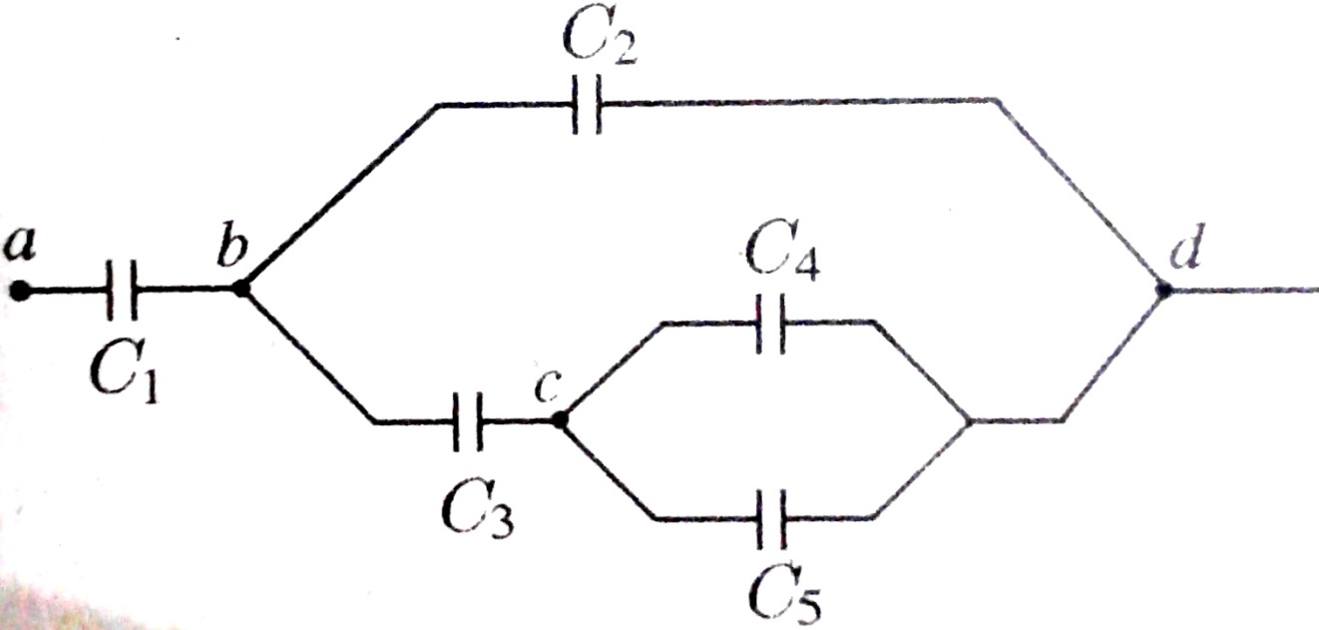
Example
Hitung kapasitas pengganti rangkaian dengan C₁ = 8 μF, C₂ = 6 μF, C₃ = 12 μF, C₄ = 6 μF, C₅ = 6 μF. Jika beda potensial V_{ad} = 10 volt. Hitung besar muatan pada masing-masing kapasitor dan potensial pada cabang b-c

Slide 14
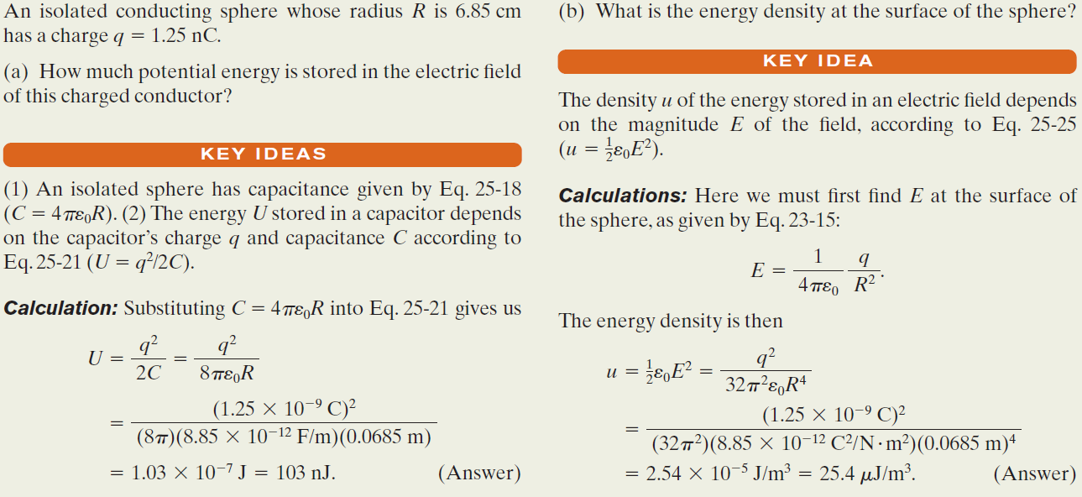
Example, Potential Energy and Energy Density of an Electric Field:

Slide 15
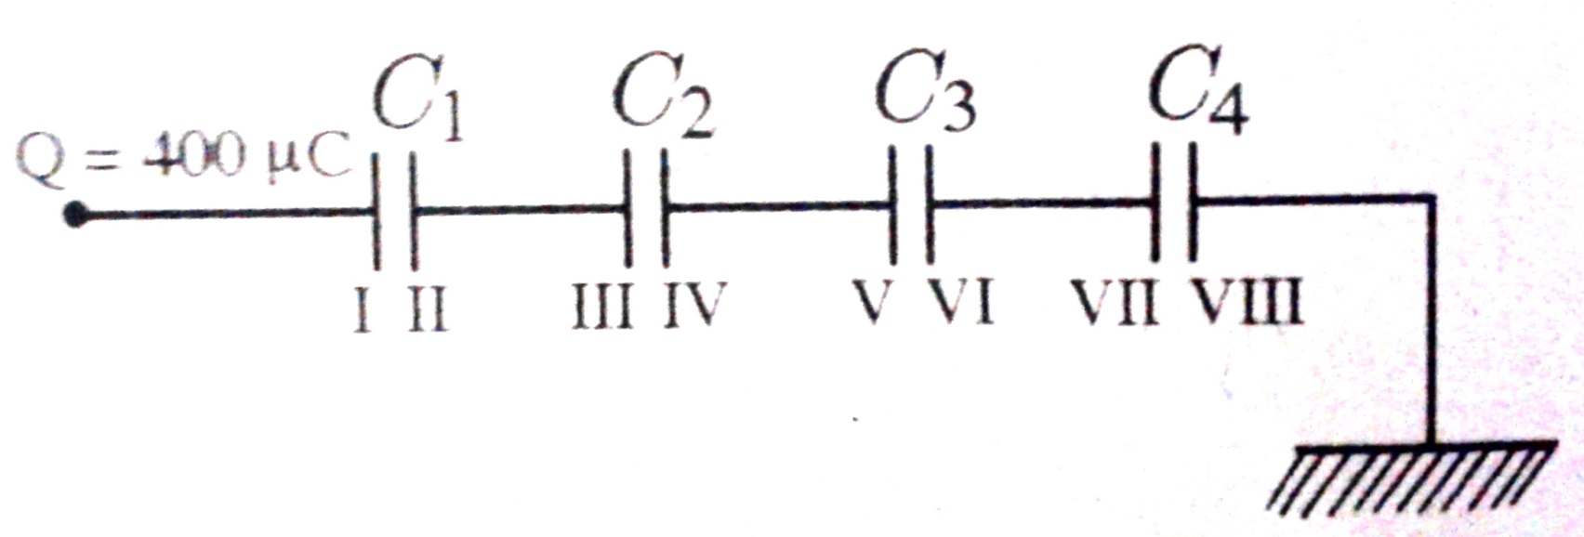
Exercise
Pada rangkaian kapasitor berikut ini C₁ = 4 μF, C₂ = 6 μF, C₃ = 12 μF, C₄ = 2 μF. Bidang I diberi muatan 400 μC, bidang VIII dibumikan., dan jarak antara dua keoing kapasitor berturut-turut adalah 2 mm, 2 mm, 4 mm, dan 8 mm. Tentukan:
Potensial masing-masing keping
Kuat medan listrik antara keping-keping kapasitor

