Slide 1
Electric Current
Wenny Maulina

Slide 2
Introducing Current Electricity
Forms of Current Electricity
Direct Current: a flow of electrons in one direction through an electric circuit
-form produced by batteries

Slide 3
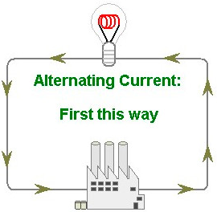
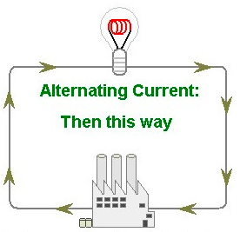
Introducing Current Electricity
Forms of Current Electricity
Alternating Current: a flow of electrons that alternates in direction in an electric circuit
-produced in generating stations because it's more efficient at distributing electricity long distances

Slide 4
Electric Current
Electric current I is the rate of the flow of charge Q through a cross-section A in a unit of time t.
+
+Q
A
t
Wire
-
One ampere A is charge flowing at the rate of one coulomb per second.

Slide 5
Example
The electric current in a wire is 6 A. How many electrons flow past a given point in a time of 3 s?
I = 6 A

Slide 6
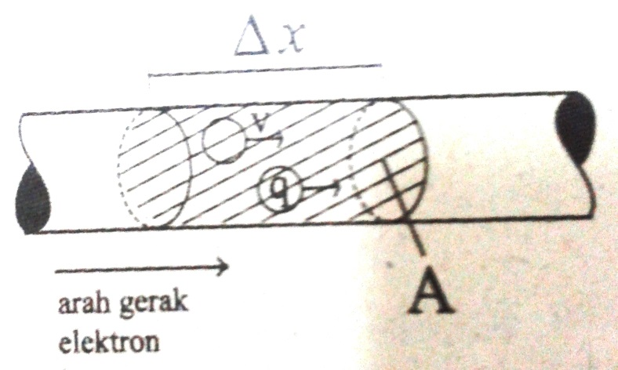
Drift Velocity
When there is a current, the random speed of electrons ~ 10⁶ m/s; however, the drift velocity (v_{d}) of electrons ~ 10⁻⁴ m/s, in the direction opposite of the direction of the applied electric field that causes the current.
$$∆Q=nA\left(∆x\right)q$$
$$∆Q=nA\left(v_{d}∆t\right)q$$
$$I=\frac{∆Q}{∆t}=nqAv_{d}$$

Slide 7
Example
Tentukan kecepatan drift (alir) elektron pada suatu kawat tembaga berjari-jari 0,815 mm yang dialiri arus 1 A? (kerapatan (massa jenis) tembaga 8,93 g/cm³ dan massa atom tembaga 63,5 gram/mol)

Slide 8
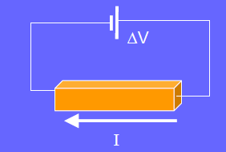
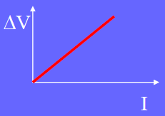
Ohm’s Law
Ohm’s law states that the current I through a given conductor is directly proportional to the potential difference V between its end points.
Ohm’s law allows us to define resistance R and to write the following forms of the law:

Slide 9
What is Resistance?
The opposition to the flow of an electric current, producing heat.
The greater the resistance, the less current gets through.
Good conductors have low resistance.
Measured in ohms.

Slide 10
What Influences Resistance?
Material of wire – aluminum and copper have low resistance
Thickness – the thicker the wire the lower the resistance
Length – shorter wire has lower resistance
Temperature – lower temperature has lower resistance

Slide 11
Resistivity of a Material
The resistivity ρ is a property of a material that determines its electrical resistance R.
Recalling that R is directly proportional to length L and inversely proportional to area A, we may write:
The unit of resistivity is the ohm-meter (Ω•m)

Slide 13
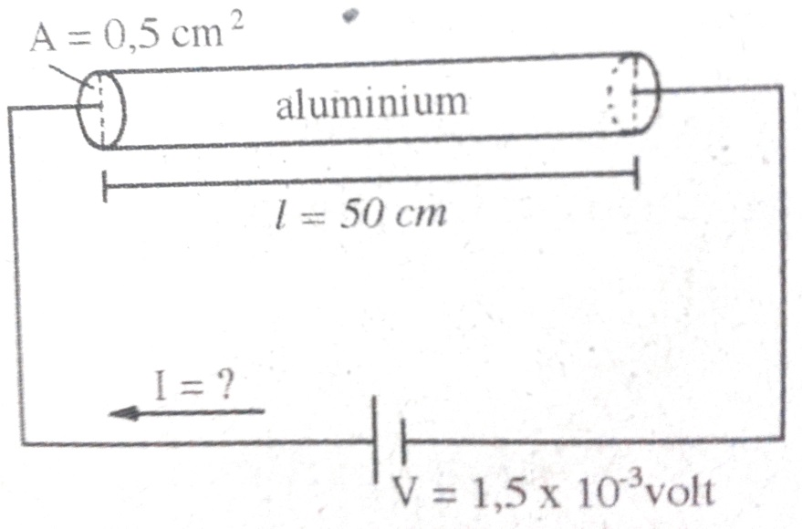
Example
Hitung hambatan sebatang aluminium yang panjangnya 50 cm dan luas penampang 0,5 cm². Hambatan jenis aluminium 2,75 x 10⁻⁸Ω.m. Jika pada ujung-ujung kawat diberi tegangan (beda potensial) 1,5 x 10⁻³ volt, hitung arus yang mengalir!

Slide 14
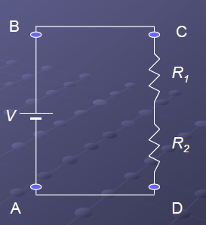
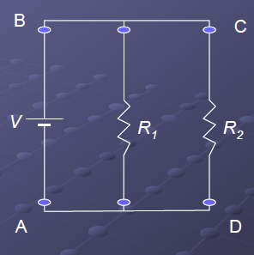
Electrical Circuit
$$Series$$
$$Paralel$$
$$\frac{1}{R}=\frac{1}{R_{1}}+\frac{1}{R_{2}}$$
$$R=R_{1}+R_{2}$$
$$I=I_{1}=I_{2}$$
$$V=V_{1}=V_{2}$$
$$V=V_{1}+V_{2}$$
$$I=I_{1}+I_{2}$$

Slide 15
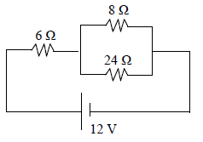
Example
Perhatikan gambar rangkaian listrik searah berikut ini!
Tentukan kuat arus listrik pada hambatan 24Ω !

Slide 16
Voltage, Current, and Power
One Volt is a Joule per Coulomb (J/C)
One Amp of current is one Coulomb per second
If I have one volt (J/C) and one amp (C/s), then multiplying gives Joules per second (J/s)
this is power: J/s = Watts
So the formula for electrical power is just:
More work is done per unit time the higher the voltage and/or the higher the current
P = VI: power = voltage × current

Slide 17
Electric Power
Electric power P is the rate at which electric energy is expended, or work per unit of time.
To charge C: Work = qV
V
q
Substitute q = It , then:
I
V
P = VI

Slide 18
Calculating Power
Using Ohm’s law, we can find electric power from any two of the following parameters: current I, voltage V, and resistance R.
Ohm’s law: V = IR

Slide 19
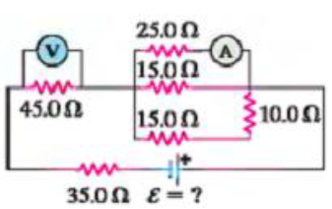
Example
Pada rangkaian di samping, besar arus yang terukur pada amperemeter sebesar 1,25 A. Tidak ada hambatan dalam pada baterai. Hitung:
Nilai yang terbaca pada voltmeter
Nilai ggl (ε) baterai

