Slide 1
Kirchoff Laws
Wenny Maulina

Slide 3
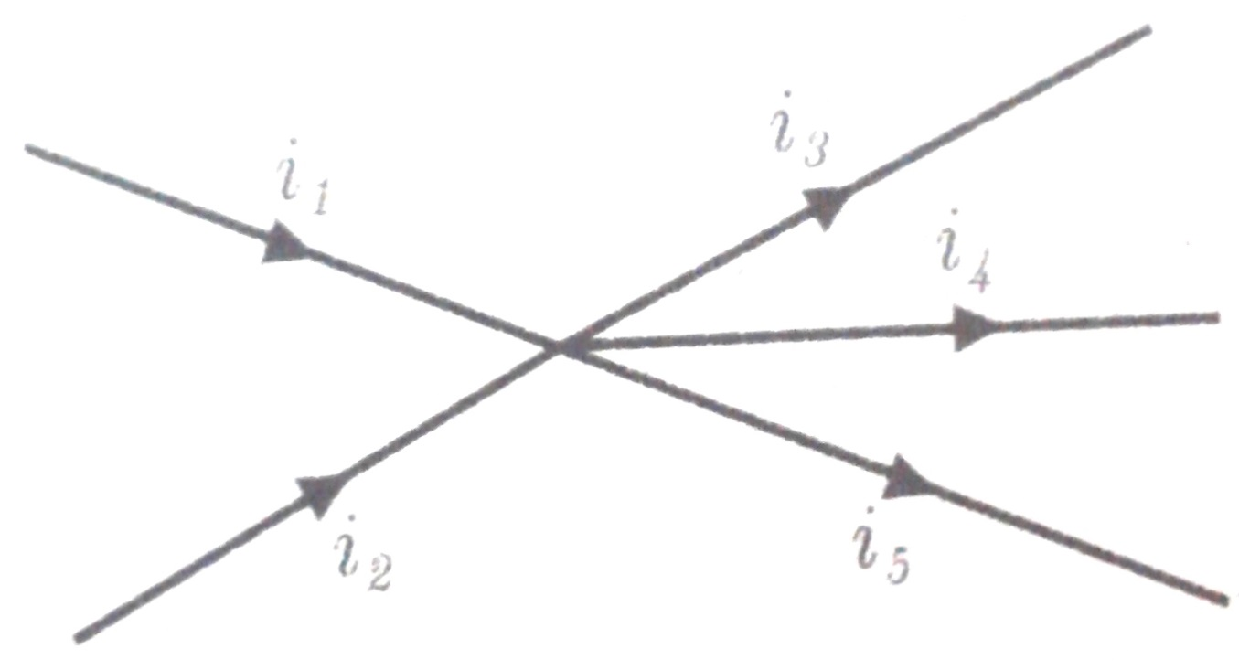
Example
$$I_{1}=2 A$$
$$I_{2}=1 A$$
$${ I}_{3} =0,5 A$$
$I_{4}=1,5 A$
$$I_{5}=?$$

Slide 5
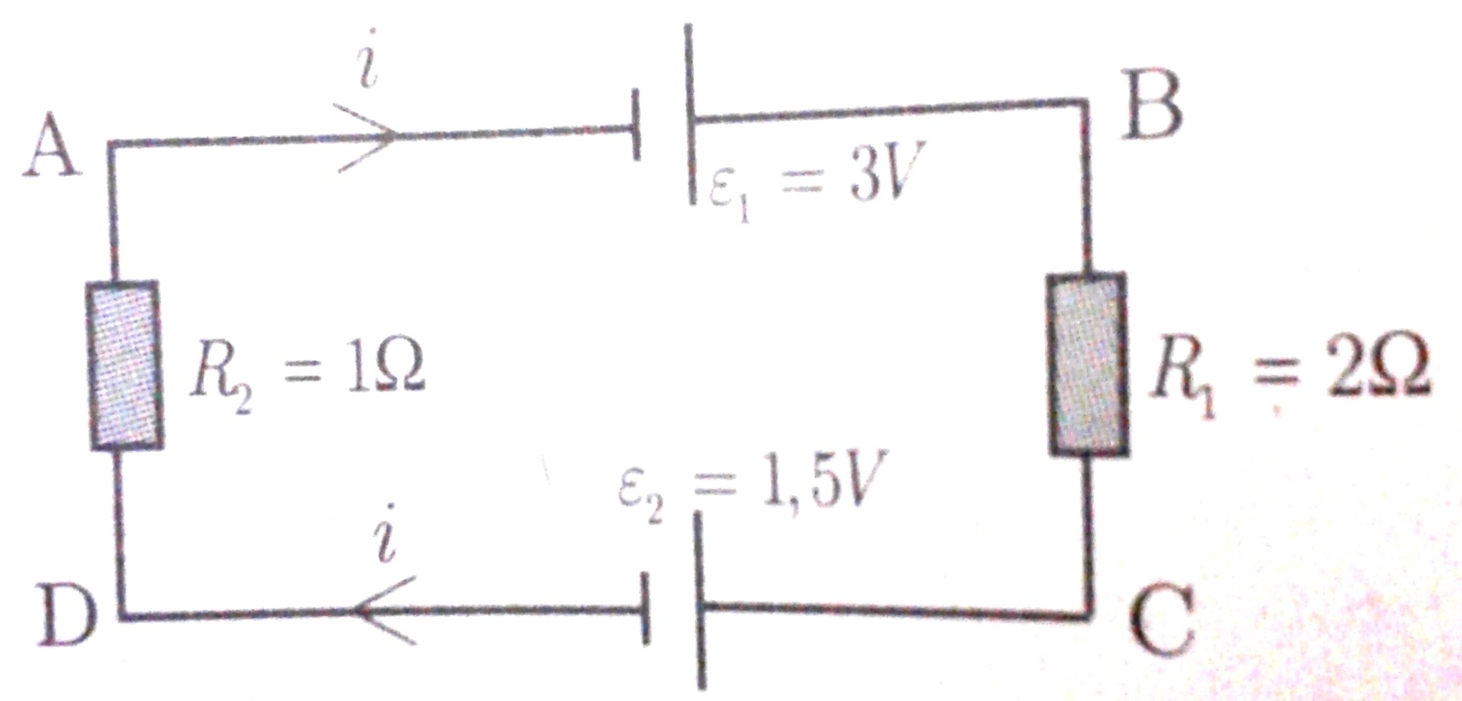
Example
$$i= ?$$
$$V_{BC}= ?$$

Slide 6
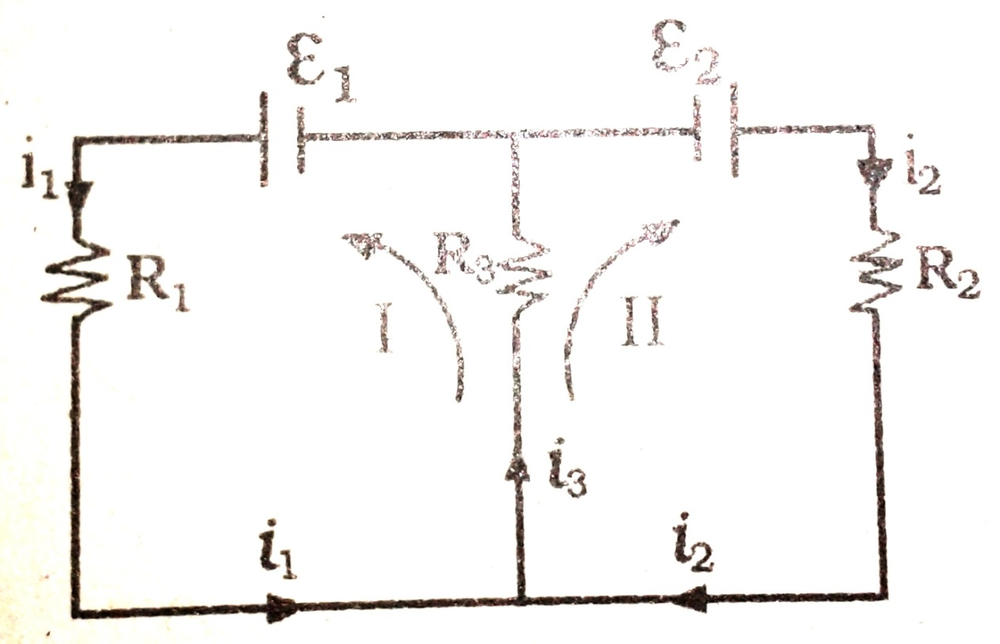
Example
$$ε_{1}=18 volt$$
$$ε_{2}=10 volt$$
$$R_{1}=2 ohm$$
$$R_{2}=4 ohm$$
$$R_{3}=6 ohm$$
$$i_{1},i_{2},i_{3} ?$$

Slide 7
Wheatstone Bridge
The Wheatstone bridge consists of four resistive arms forming two voltage dividers and a direct voltage source. The output is taken between the dividers. Frequently, one of the bridge resistors is adjustable.
When the bridge is balanced, the output voltage is zero, and the products of resistances in the opposite diagonal arms are equal

Slide 8
Example
What is the value of R₂ if the bridge is balanced?
470 Ω
330 Ω
12 V
270 Ω

Slide 9
Example
An unbalanced Wheatstone bridge has the voltages shown. What is the voltage across R₄ ?

Slide 10
Example
Assume R₂ is adjusted until the Wheatstone bridge is balanced. At this point, the voltage across R₄ is measured and found to be 5.0 V. What is the voltage across R₁ ?

Slide 11
Exercise
a
•
${Tentukan V}_{ab} ?$
5V
10Ω
10Ω
10V
5Ω
15V
•
b

