Slide 1
Magnetic Fields and Forces
Wenny Maulina

Slide 2
Facts about Magnetism

Slide 3
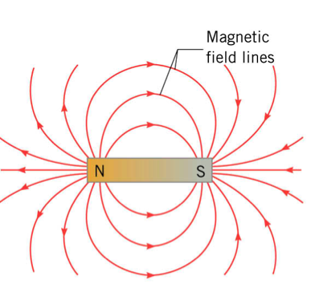
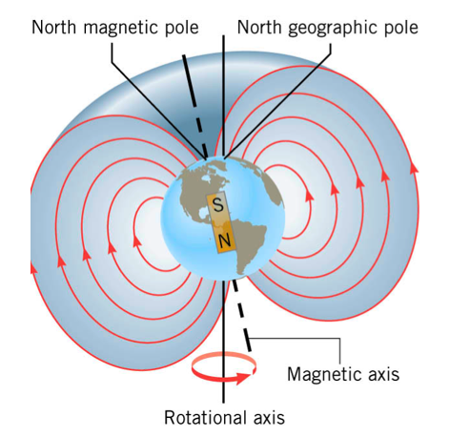
Magnetic Field

Slide 4
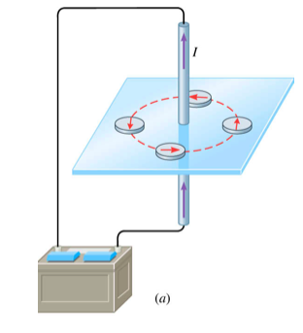
Magnetic field due to current (direction)
Oersted (1820)

Slide 5
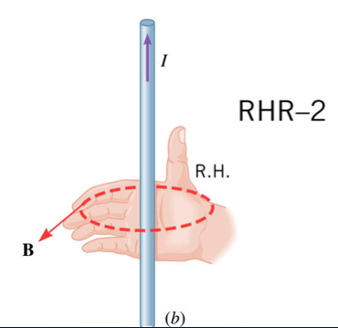
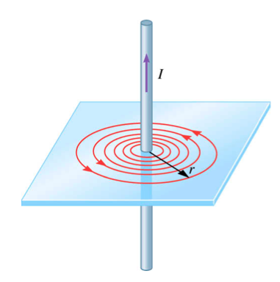

Slide 6
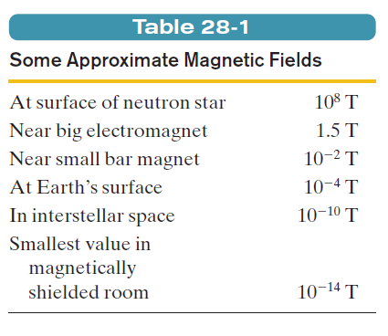
The SI unit for B is newton per coulomb-meter per second. For convenience, this is called the tesla (T):
An earlier (non-SI) unit for B is the gauss (G), and

Slide 7
Example
Determine the direction of the magnetic fields at given points P, Q, R, S dan T
T
I
X
P
Q
R
S

Slide 8
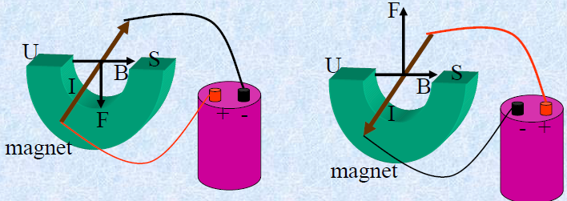
Magnetic Force

Slide 9
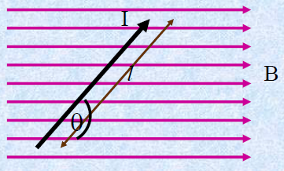
The force on a current carrying wire in a magnetic field.
A current carry wire has charge moving through it.
Each of the moving charges will experience a force due to the magnetic field
The individual magnetic forces on each charge will produce a net force on the entire wire.
The magnitude of the force is given by the equation below:

Slide 10
The direction is given by right-hand rule :
Fingers: Point in the direction of the field.
Thumb: Points in the direction of the current flow.
Palm of hand: Points in the direction of the force on a positive charge.
F
F
N
S
B
I or v
B
I

Slide 11
B_{in}
X X X X X X X X X
X X X X X X X X X
X X X X X X X X X
X X X X X X X X X
X X X X X X X X X
X X X X X X X X X
X X X X X X X X X
Direction: Downward (-y direction)
I
F_{B}

Slide 12
B_{out}
• • • • • • • • •
• • • • • • • • •
• • • • • • • • •
• • • • • • • • •
• • • • • • • • •
F_{B}
Direction: To the left (-x direction)
I

Slide 13
Example
A wire carrying a 20A current and having a length of 0.1m is placed between the poles of two magnets as shown below. The magnetic field is uniform and has a value of 0.8T. Determine the magnitude and direction of the magnetic force acting on the wire.
I
N
S

Slide 14
Example
A wire is bent into a square loop and placed completely in a magnetic field B = 1.2T. Each side of the loop has a length of 0.1m and the current passing through the loop is 2A. The loop and magnetic field is in the plane of the page.
(a) Find the magnitude of the initial force on each side of the wire.
(b) Determine the initial net torque acting on the loop.
B
I

Slide 15
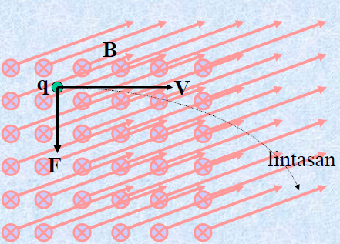
The Magnetic Force on a moving charge in an external magnetic field.
A moving charge creates a magnetic field, therefore it will experience a magnetic force as it moves through an external magnetic field.
The direction of the force is given by right-hand rule.
The magnitude of this force is given by the equation:

Slide 16
The direction is given by right-hand rule :
Fingers: Point in the direction of the field.
Thumb: Points in the direction of the charge velocity.
Palm of hand: Points in the direction of the force on a positive charge.
Back of hand: Points in the direction of the force on a negative charge.
F
F
N
S
v
B
I or v
B

Slide 17
B_{in}
X X X X X X X X X
X X X X X X X X X
X X X X X X X X X
X X X X X X X X X
X X X X X X X X X
X X X X X X X X X
X X X X X X X X X
F_{B}
+
v
Direction: Upward toward the top of the page.

Slide 18
B_{out}
• • • • • • • • •
• • • • • • • • •
• • • • • • • • •
• • • • • • • • •
• • • • • • • • •
v
F_{B}
-
Direction: Left. Negative x direction.

Slide 19
Example
Determine the direction of the unknown variable for a proton moving in the field using the coordinate axis given
+y
B = -x
v = +y
F =
+z
+x
?
B =+Z
v = +x
F =
B = -z
v = +y
F =
?
?

Slide 20
Example
Determine the direction of the unknown variable for a proton moving in the field using the coordinate axis given
+y
B = -x
v = +y
F =
+z
+x
+z
B =+Z
v = +x
F =
B = -z
v = +y
F =
-y
-x

Slide 21
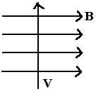
Example
Determine the direction of the unknown variable for an electron using the coordinate axis given.
+y
B = +x
v = +y
F =
+z
+x
?
F
B
B =
v = - x
F = +y
?
B = +z
v =
F = +y
?

Slide 22
Example
Determine the direction of the unknown variable for an electron using the coordinate axis given.
+y
B = +x
v = +y
F =
+z
+x
+z
F
B
B =
v = - x
F = +y
-z
B = +z
v =
F = +y
+x

Slide 23
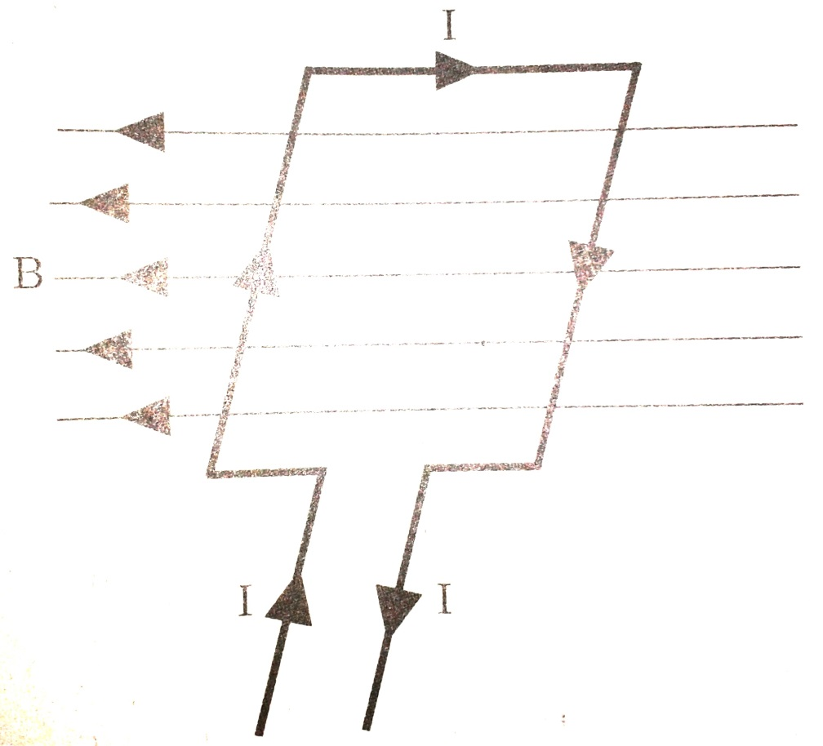
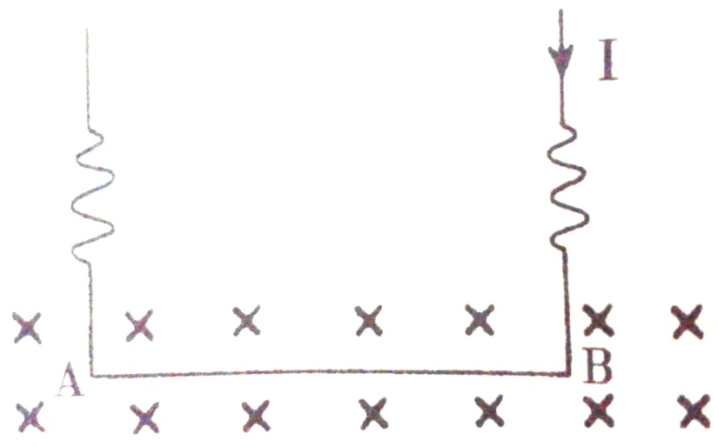
Example
Determine the direction of the magnetic force below

Slide 24
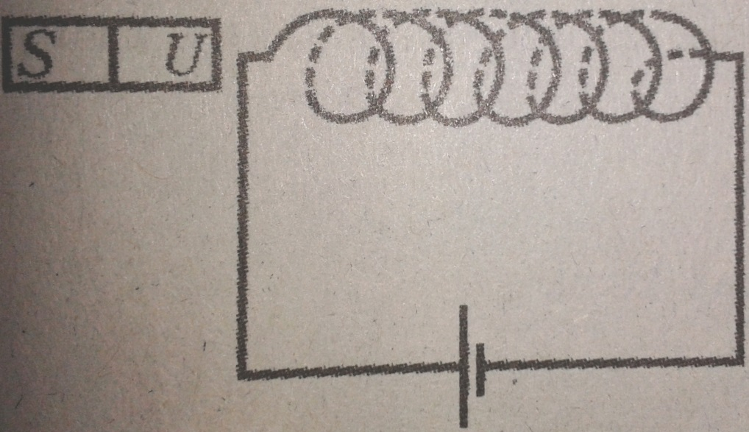
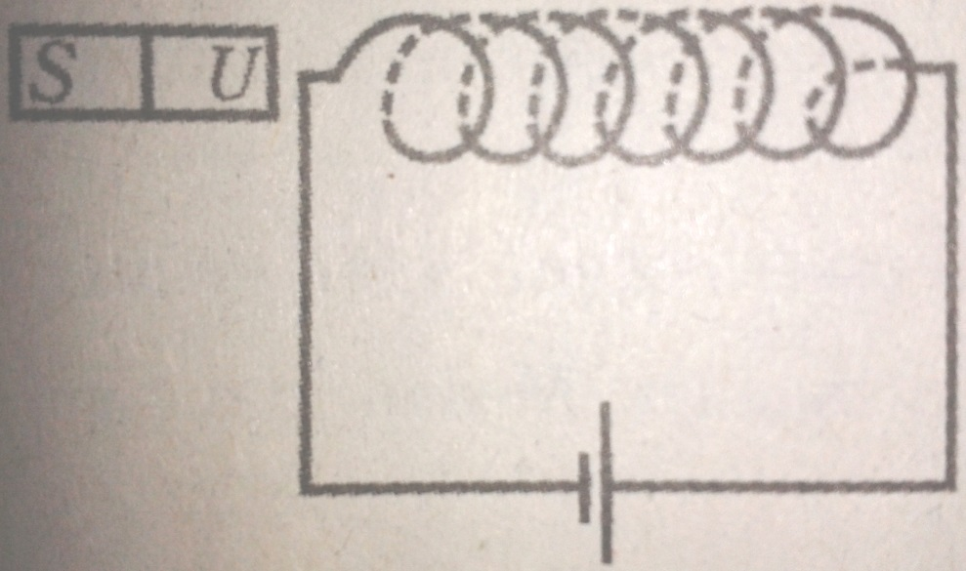
Example
Which is a wire that become repel with magnet?
(a)
(b)

