Slide 1
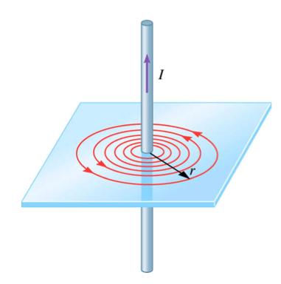
Field due to long straight wire (magnitude)
The magnetic field, B, is directly proportional to the current, I, and inversely proportional to the circumference.

Slide 2
Example
A long, straight wires carries a current of 5 A. At one instant, a proton, 4 mm from the wire travels at 1500 m/s parallel to the wire and in the same direction as the current. Find the magnitude and direction of the magnetic force acting on the proton due to the field caused by the current carrying wire.
v
X X X
X X X
X X X
X X X
X X X
X X X
4mm
+
5A

Slide 3
Example
A long, straight wires carries a current of 5 A. At one instant, a proton, 4 mm from the wire travels at 1500 m/s parallel to the wire and in the same direction as the current. Find the magnitude and direction of the magnetic force acting on the proton due to the field caused by the current carrying wire.
v
X X X
X X X
X X X
X X X
X X X
X X X
4mm
+
B = -z
v = +y
F =
5A
-x

Slide 4
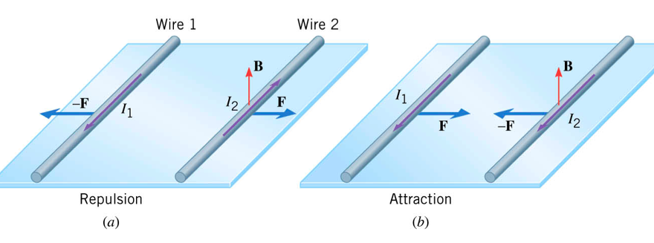
Force between parallel wires

Slide 5
Example
Find the magnetic field midway between the two current carrying wires shown in the diagram. Will the wires attract or repel each other?
Find the magnetic forced from the two current carrying wires shown in the diagram. If the length of wire is 2m?
40cm
I = 2A
I = 3A

Slide 6
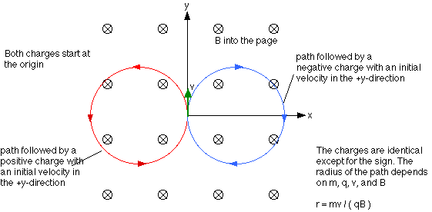
Magnetic Force and Circular Motion
v
B
X X X X X X X X X
X X X X X X X X X
X X X X X X X X X
X X X X X X X X X
Suppose we have an electron traveling at a velocity , v, entering a magnetic field, B, directed into the page. What happens after the initial force acts on the charge?
-
-
F_{B}
-
F_{B}
F_{B}
-
F_{B}
-

Slide 7
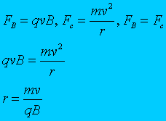
Magnetic Force and Circular Motion
The magnetic force is equal to the centripetal force and thus can be used to solve for the circular path. Or, if the radius is known, could be used to solve for the MASS of the ion. This could be used to determine the material of the object.
There are many “other” types of forces that can be set equal to the magnetic force.

Slide 8
Example
A singly charged positive ion has a mass of 2.5 x 10⁻²⁶ kg. After being accelerated through a potential difference of 250 V, the ion enters a magnetic field of 0.5 T, in a direction perpendicular to the field. Calculate the radius of the path of the ion in the field.
We need to solve for the velocity!
0.0177 m
56,568 m/s

Slide 9
The Biot-Savart Law
Wenny Maulina

Slide 10
Biot and Savart recognized that a conductor carrying a steady current produces a force on a magnet.
Biot and Savart produced an equation that gives the magnetic field at some point in space in terms of the current that produces the field.
Biot-Savart law says that if a wire carries a steady current I, the magnetic field dB at some point P associated with an element of conductor length ds has the following properties:
  The vector dB is perpendicular to both ds (the direction of the current I) and to the unit vector r_{hat} directed from the element ds to the point P.

Slide 11
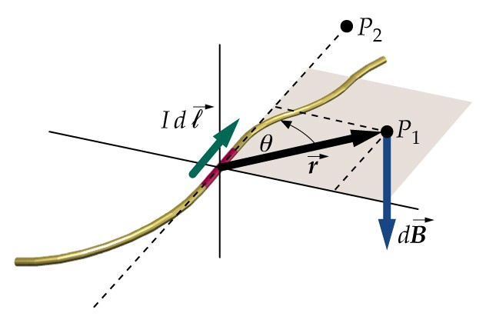

Slide 12
  The magnitude of dB is inversely proportional to r², where r is the distance from the element ds to the point P.
  The magnitude of dB is proportional to the current I and to the length ds of the element.
  The magnitude of dB is proportional to sin θ, where θ is the angle between the vectors ds and r_{hat}.
Biot-Savart law:

Slide 13
μ_{o} is a constant called the permeability of free space; μ_{o} =4·π x 10⁻⁷ Wb/A·m (T·m/A)
Biot-Savart law gives the magnetic field at a point for only a small element of the conductor ds.
To determine the total magnetic field B at some point due to a conductor of specified size, we must add up every contribution from all elements ds that make up the conductor (integrate)!

Slide 14
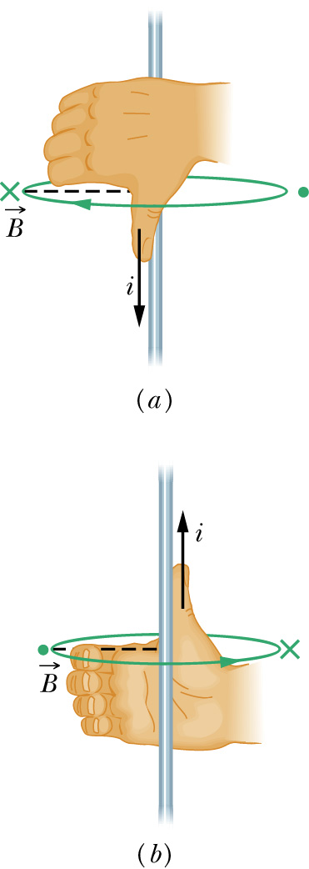
The direction of the magnetic field due to a current carrying element is perpendicular to both the current element ds and the radius vector r_{hat}.
The right hand rule can be used to determine the direction of the magnetic field around the current carrying conductor:
  Thumb of the right hand in the direction of the current.
  Fingers of the right hand curl around the wire in the direction of the magnetic field at that point.

Slide 15
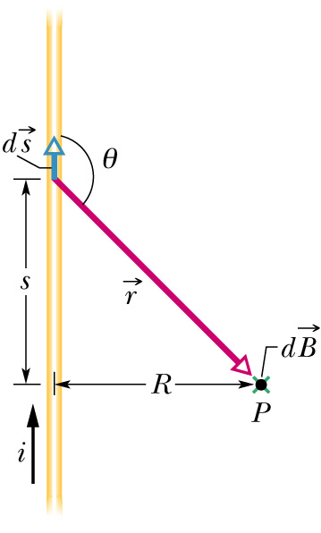
Magnetic Field of a Thin Straight Conductor
Consider a thin, straight wire carrying a constant current I along the x axis. To determine the total magnetic field B at the point P at a distance a from the wire:

Slide 16
Use the right hand rule to determine that the direction of the magnetic field produced by the conductor at point P is directed out of the page.
This is also verified using the vector cross product (ds x r_{hat}): fingers of right hand in direction of ds; point palm in direction of r_{hat} (curl fingers from ds to r_{hat}); thumb points in direction of magnetic field B.
The cross product (ds x r_{hat}) = ds·r_{hat}·sin θ; r_{hat} is a unit vector and the magnitude of a unit vector = 1.
(ds x r_{hat}) = ds·r_{hat}·sin θ = ds·sin θ

Slide 17
Each length of the conductor ds is also a small length along the x axis, dx.
Each element of length ds is a distance r from P and a distance x from the midpoint of the conductor O. The angle θ will also change as r and x change.
The values for r, x, and θ will change for each different element of length ds.
Let ds = dx, then ds·sin θ becomes dx·sin θ.
The contribution to the total magnetic field at point P from each element of the conductor ds is:

Slide 18
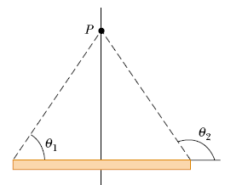
When the angles are provided:
  express r in terms of a and the angle θ:
  Because angles are involved, we need to change dx to dθ:
        - Take the derivative of x:

Slide 19
To determine the magnitude of the magnetic field B, integrate:

Slide 20
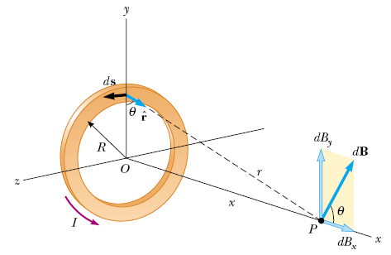
Magnetic Field on the Axis of a Circular Current Loop
Consider a circular loop of wire of radius R in the yz plane and carrying a steady current I:

Slide 21
To determine the magnetic field B at a point P on the axis a distance x from the center of the loop:
  Divide the current loop into small elements of length ds.
  Each element of length ds is the same distance r to point P on the x axis.
  Each element of length ds contributes equally to the total magnetic field B at point P.

Slide 22
Express r in terms of R and x:
Each element of length ds is perpendicular to the unit vector r_{hat} from ds to point P.
Substituting into the integral equation:

Slide 23
Notice that the direction of the magnetic field contribution dB from element of length ds is at an angle θ with the x axis.

Slide 24
The direction of the net magnetic field is along the x axis and directed away from the circular loop.

Slide 25
Express R² + x² in terms of an angle θ:
Substituting into the integral equation:

Slide 26
Pull the constants out in front of the integral:
The sum of the elements of length ds around the closed current loop is the circumference of the current loop; s = 2·π·R

Slide 27
The net magnetic field B at point P is given by:

Slide 28
To determine the magnetic field strength B at the center of the current loop, set x = 0:

Slide 29
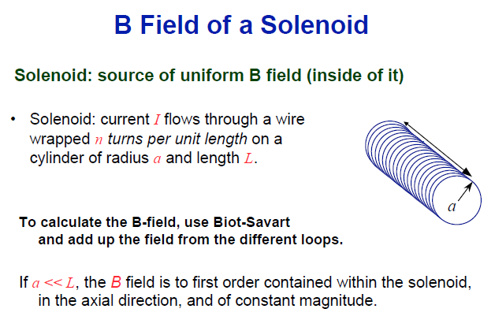
Magnetic Field of a Solenoid

Slide 30
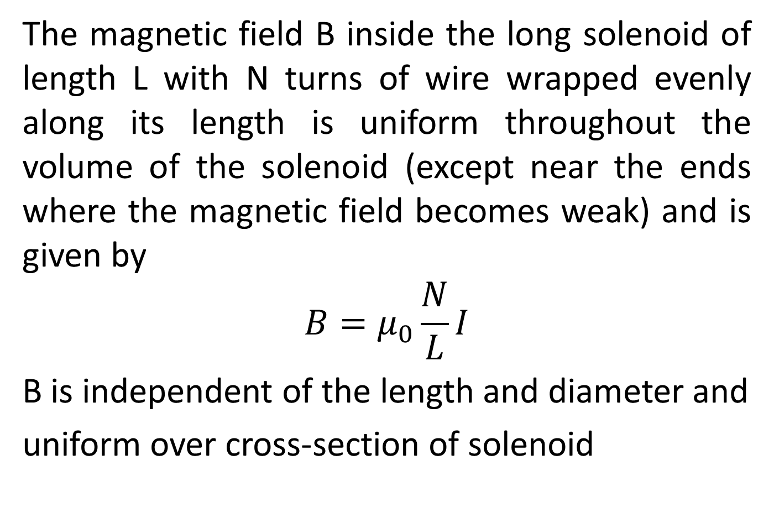
The magnetic field B inside the long solenoid of length L with N turns of wire wrapped evenly along its length is uniform throughout the volume of the solenoid (except near the ends where the magnetic field becomes weak) and is given by
$$B=μ_{0}\frac{N}{L}I$$
B is independent of the length and diameter and
uniform over cross-section of solenoid

Slide 31
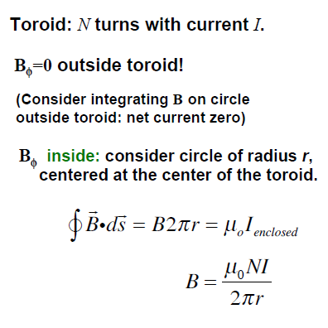
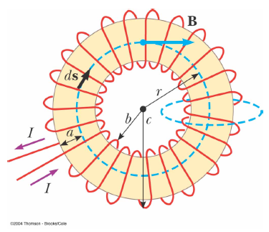
Magnetic Field of a Toroid

Slide 32
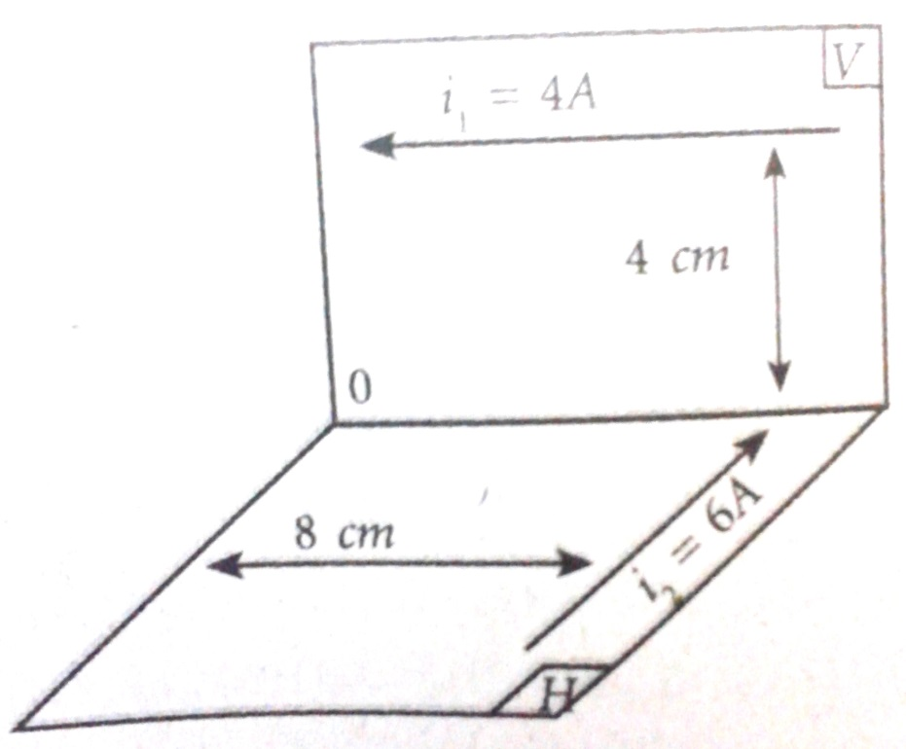
Example
Dua bidang H dan V saling tegak lurus. Pada kedua bidang tersebut terdapat kawat panjang yang masing-masing dialiri arus 4A dan 6A. Hitung besar kuat medan magnetik di titik O

Slide 33
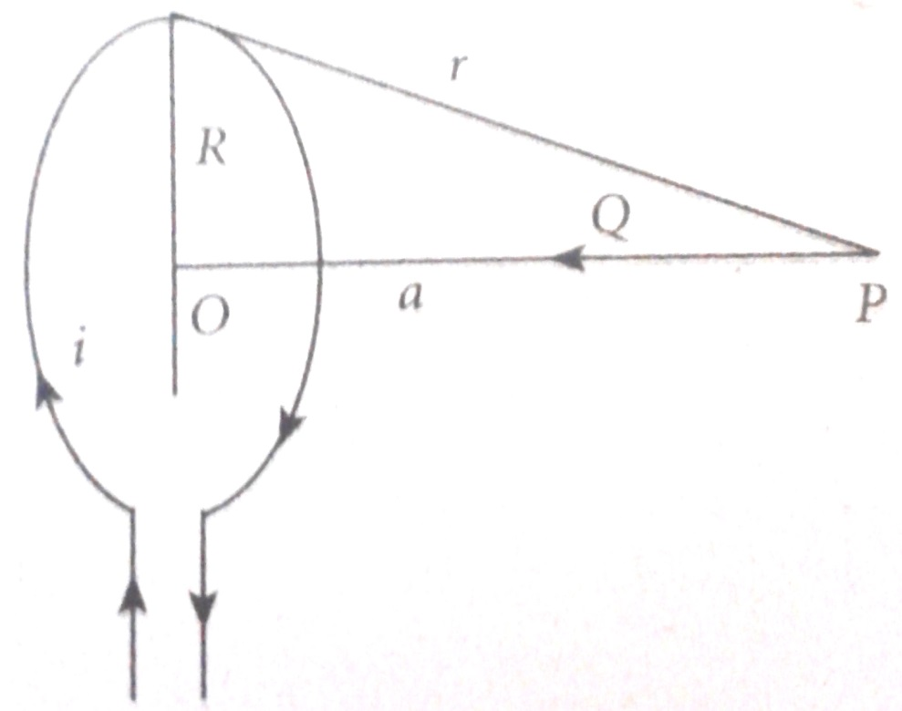
Exercise
Suatu kawat berbentuk lingkaran dengan jari-jari 3 cm. Hitung besar kuat medan magnetik di titik P yang berjarak 4 cm dari pusat lingkaran O. Jika kawat dialiri arus 5A.

Slide 34
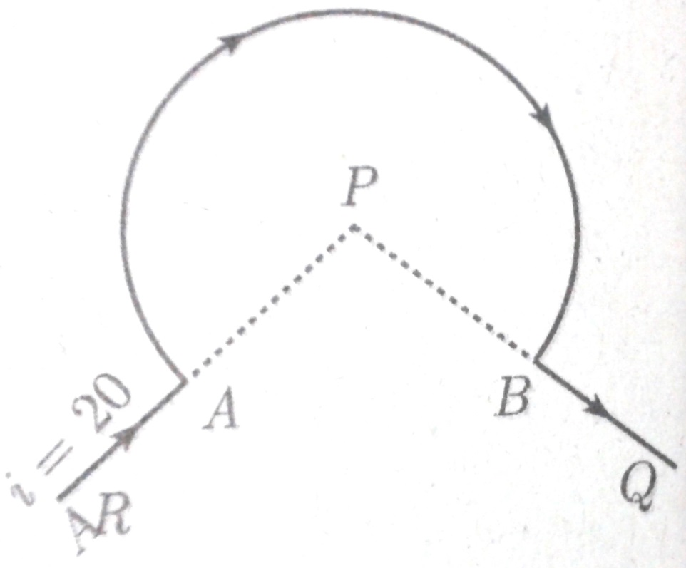
Exercise
Sebuah kawat di lengkungkan seperti pada gambar dengan jari-jari 3cm. Hitung besar kuat medan magnetik di titik P jika kawat dialiri arus 20A.

