Slide 1
Hukum Konservasi
Muatan dan energi

Slide 2
Persamaan Kontinuitas “The tiger can’t simply rematerialize outside the cage”
The electric charge do not instantaneously jump long distances
They have to flow at finite rate through all the intermediate locations.
charge Q contained in some volume V.
This change may change
if there is an electric current through the surface S of the volume V.
that is the only way:
the charge cannot disappear from V and jump far away without flowing through the surface.

Slide 3
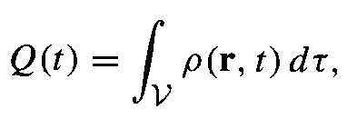
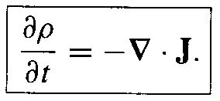
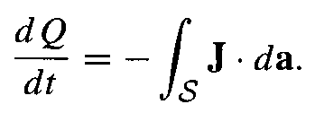
Konservasi muatan “ yo opo mikire”
Muatan dalam sebuah volume
Muatan yang melewati dinding
Konservasi muatan
Q diubah dengan rho dan aplikasi divergence
Persamaan Kontinuitas

Slide 4
Poynting’s Theorem
Usaha yang dibutuhkan
Mengumpulkan muatan tersebar
Mengalirkan arus (melawan emf)
Energi yang tersimpan dalam medan elektromagnetic

Slide 5
Dimisal : muatan dan arus menghasilkan E dan B. pada selang dt muatan bergerak. Berapa besar usaha dW
Usaha pada muatan q yang bergerak secepat v
Usaha untuk seluruh muatan dalam volume

Slide 6
Poynting’s theorem work-energy theorem of electrodynamics
The total energy stored
The rate at which energy
is carried out of V
The work done on the charges by electromagnetic force is equal to
the decrease in energy stored in the field,
Less the energy that flowed out through the surface

Slide 7
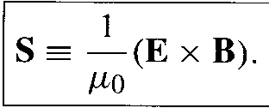
Poynting vector the energy per unit time per unit area transported by the fields

Slide 8
Work done increase mechanical energy
Energy density of the fields
Total perubahan energy

