Slide 1
Poynting’s Theorem
Beberapa Contoh

Slide 2
Review dari Poynting Theorem
Usaha untuk seluruh muatan dalam volume
Theorem Usaha Energy (Poynting’s Theorem)
The total energy stored
The rate at which energy
is carried out of V

Slide 3
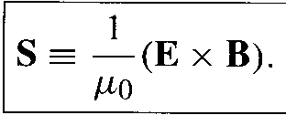
Poynting Vector

Slide 4
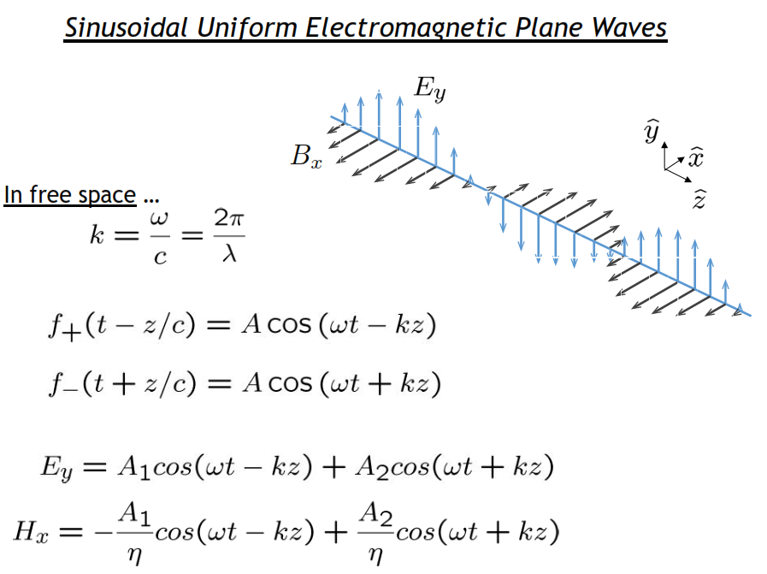
Contoh

Slide 5
Berapa Energi tersimpan ?
Plane wave bergerak di vacuum dengan arah z
Energy Tersimpan

Slide 6
Bagaimana Menghitungnya
Energi dihitung rata rata dalam satu perioda gelombang

Slide 7
Direction of an Electromagnetic Wave
the direction of the Poynting vector must be mutually perpendicular to both the electric and magnetic fields.
This relationship is expressed in terms of the cross product of the two fields:
What is the direction of the Poynting vector for an electromagnetic wave with its electric field component oscillating in the direction at an instant when its magnetic field component oscillates in the direction?

Slide 8
Wave propagation
Suppose we have an electric field wave travelling in the positive z direction.
Recall :$∇×E=−jωB$
Kalau diketahui Berapa B?
Kalau diketahui
Berapa B dalam E?

Slide 9
Jadi anda harus bisa menyatakan H dalam E
Alkisah
Real saja

Slide 10
Poynting Vector nya
Dengan phasors

Slide 11
Berapa pointing vector dari plane wave yang menjalar di free space
Diberi nama INTENSITAS

